Slide 1
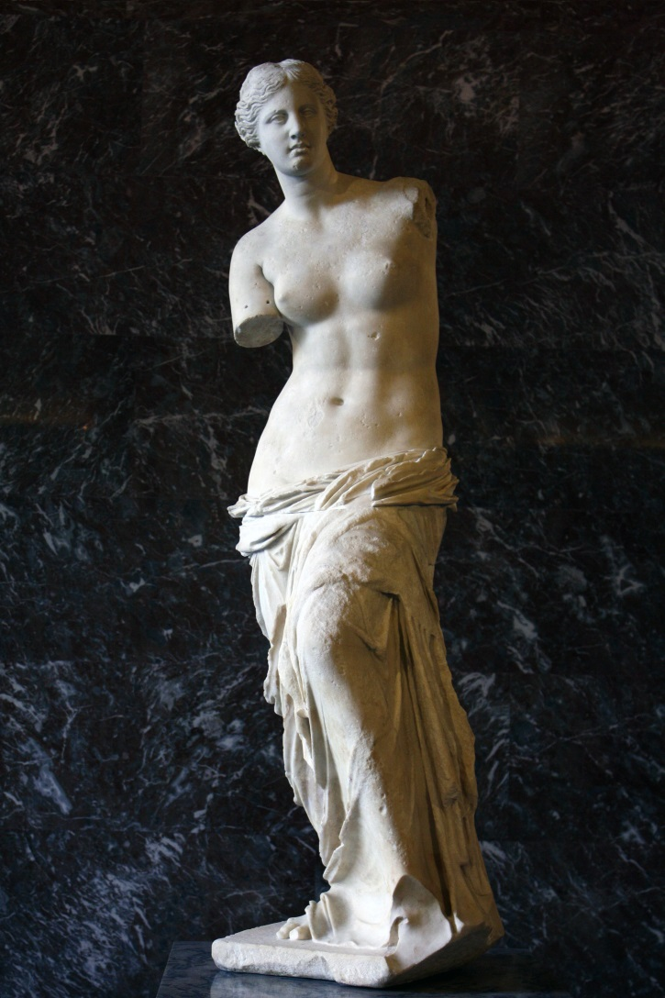
Aphrodite of Mylos (130 b.C. ca.)

Slide 2
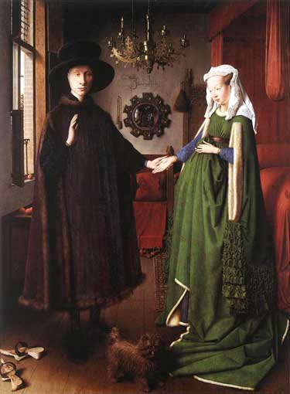
Arnolfini Portrait- Jan van Eyck (1434)

Slide 3
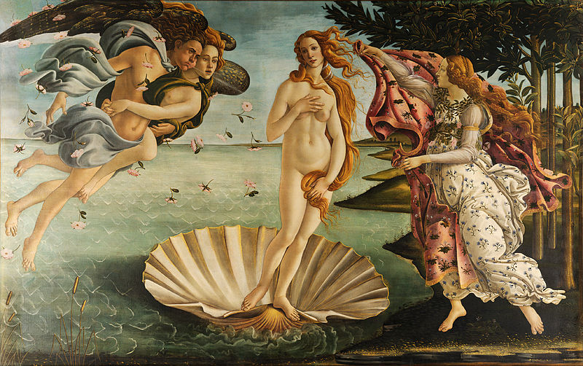
Birth of Aphrodite - Sandro Botticelli (1482/85 ca.)

Slide 4
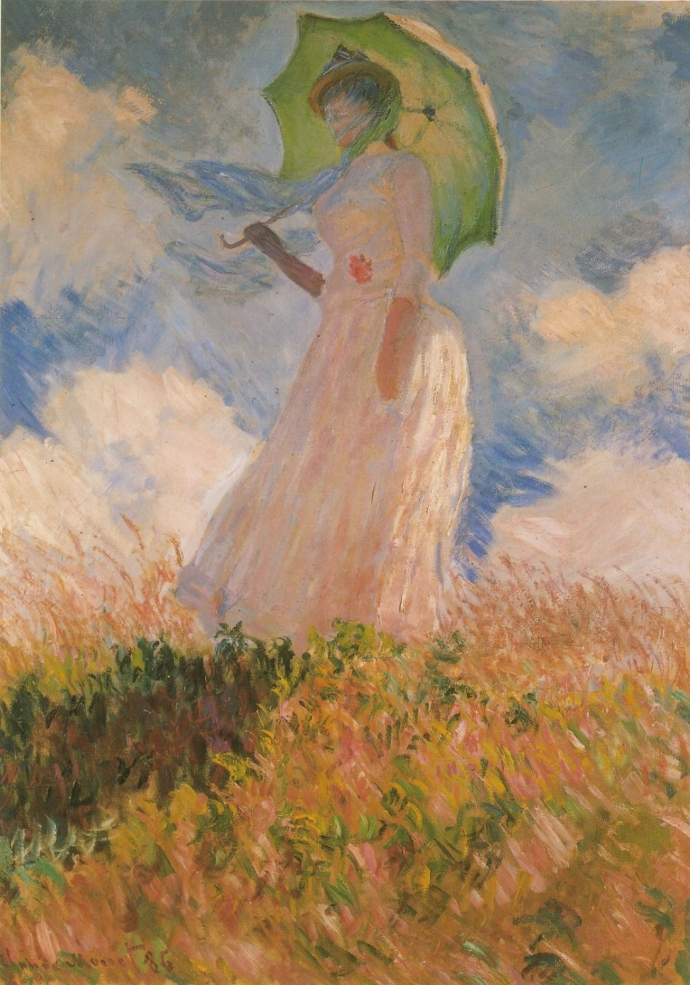
Woman with Parasol - Claude Monet (1886)

Slide 5
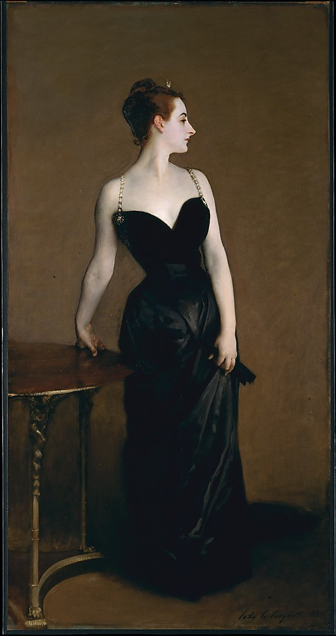
Portrait of Mme. X – John Singer Sargent (1884)

Slide 6
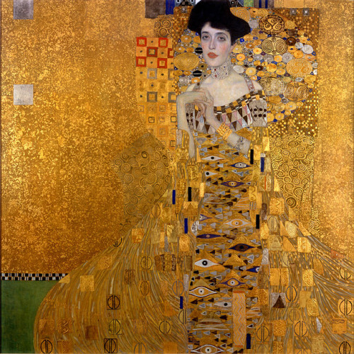
Portrait of Adele Bloch-Bauer – Gustav Klimt (1907)

Slide 7
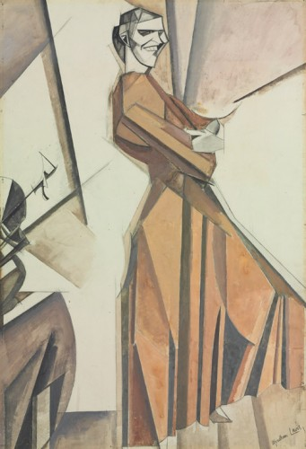
Smiling woman ascending a stair
Windham Lewis, (1912)

Slide 8
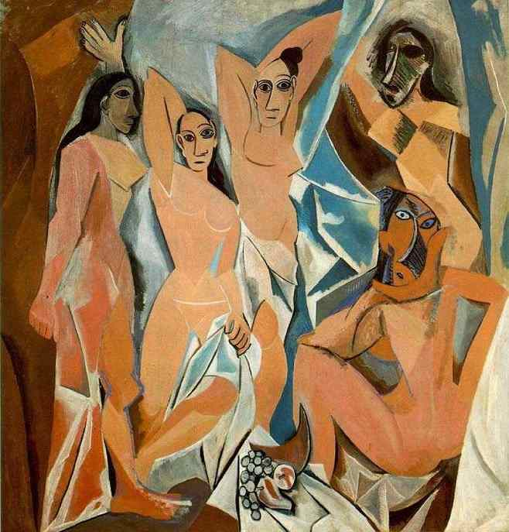
Les Demoiselles d’Avignon – Pablo Picasso (1907)

Slide 9
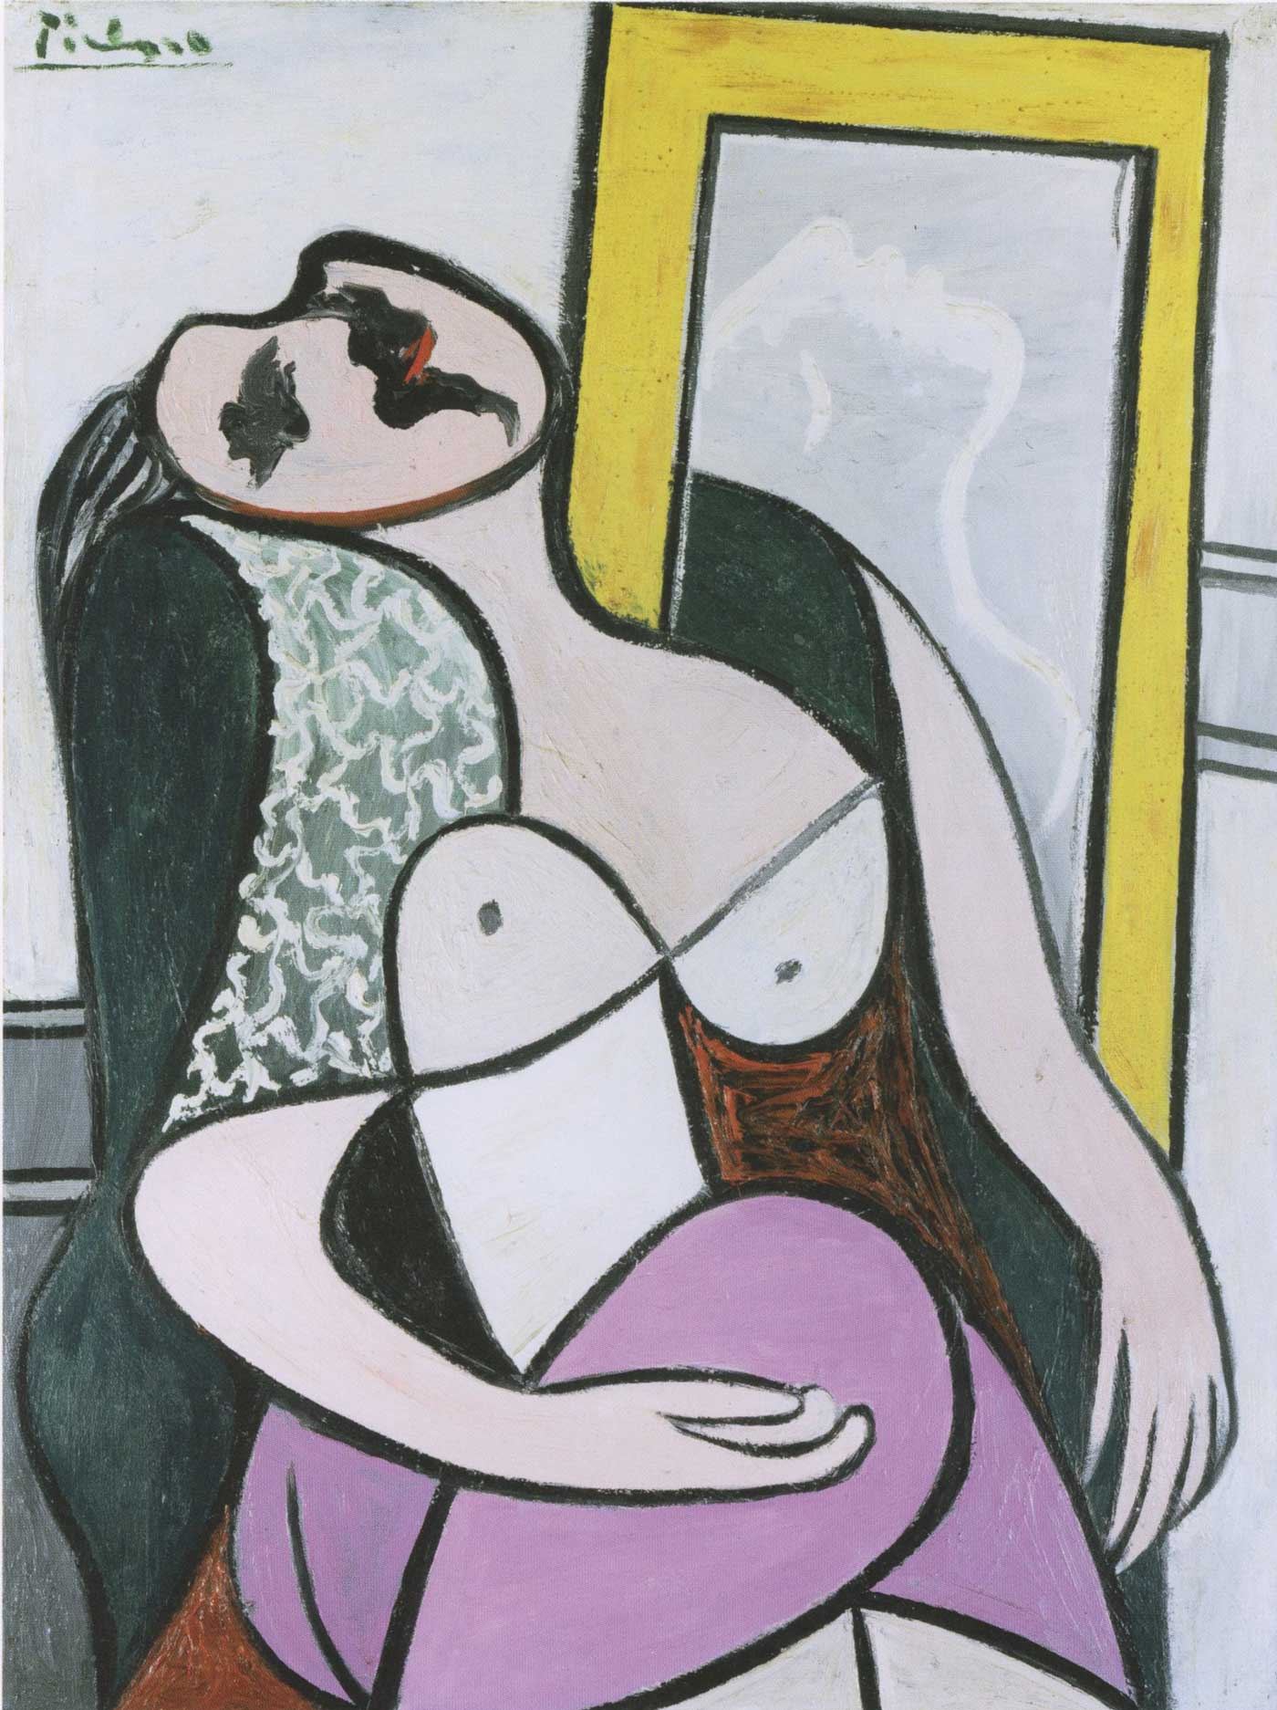
Girl in front of Mirror - Pablo Picasso (1932)

