Slide 1
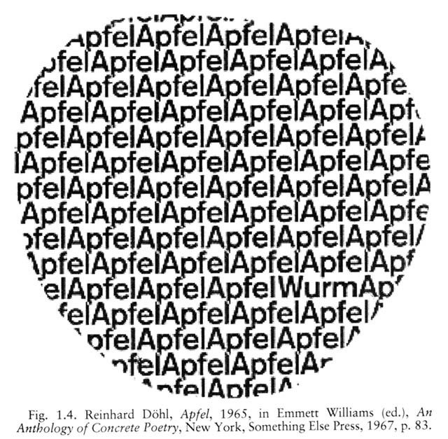
EXTRAS | VISUAL POETRY
REINHARD DÖHL
APFEL (1965)

Slide 2
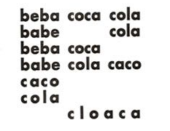
EXTRAS | VISUAL POETRY
DÉCIO PIGNATARI | BEBE COCA-COLA (1957)

Slide 3
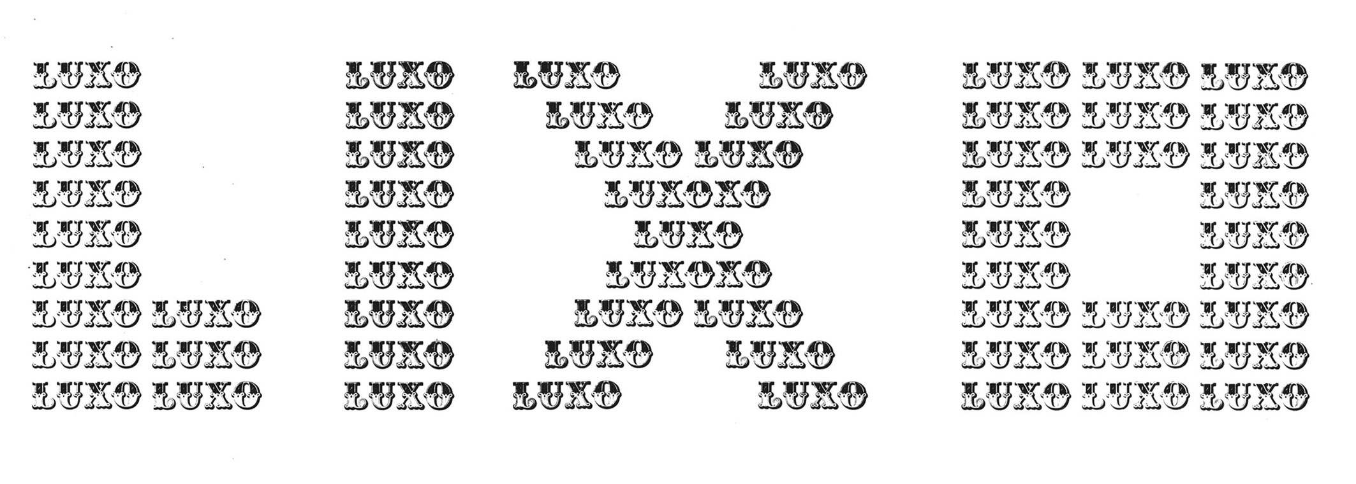
EXTRAS | VISUAL POETRY
AUGUSTO DE CAMPOS | LUXO LIXO (1966)

Slide 4
EXTRAS | VISUAL POETRY
DÉCIO PIGNATARI
TERRA (1957)

Slide 5
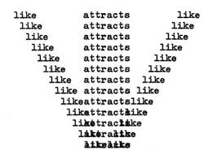
EXTRAS | VISUAL POETRY
EMMETT WILLIAMS | LIKE ATTRACTS LIKE (1967)

Slide 6
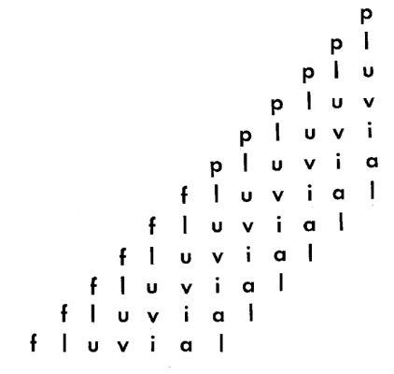
EXTRAS | VISUAL POETRY
AUGUSTO DE CAMPOS
PLUVIAL (1959)

Slide 7
EXTRAS | VISUAL POETRY
GUILLAUME APOLLINAIRE
IL PLEUT (1918)

Slide 8
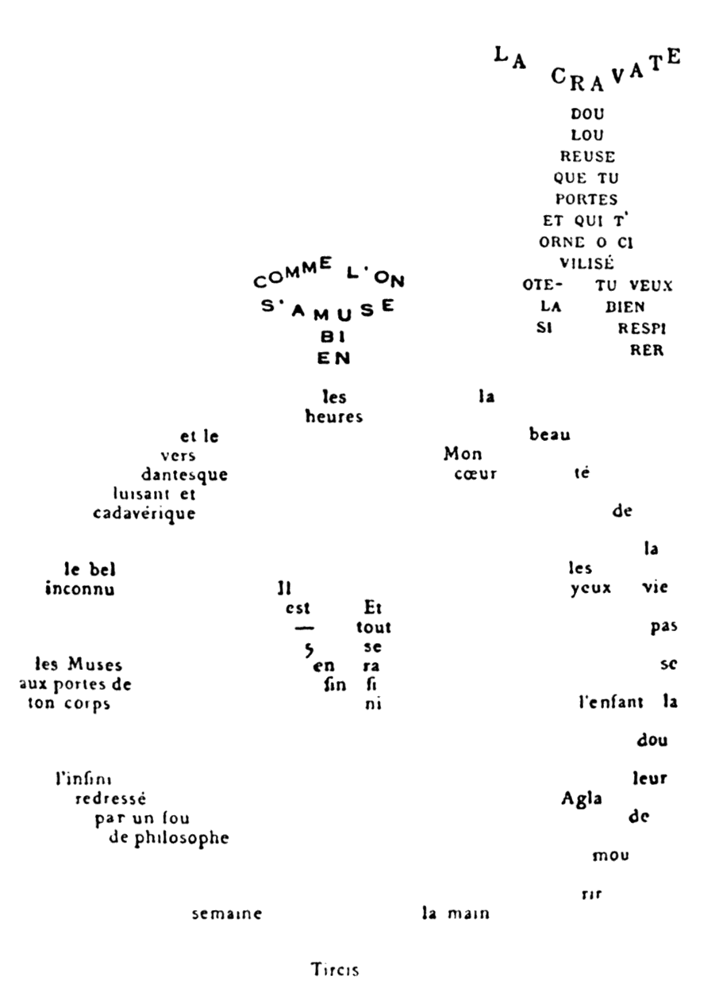
EXTRAS | VISUAL POETRY
GUILLAUME APOLLINAIRE
LA CRAVATE ET LA MONTRE
(1918)

Slide 9
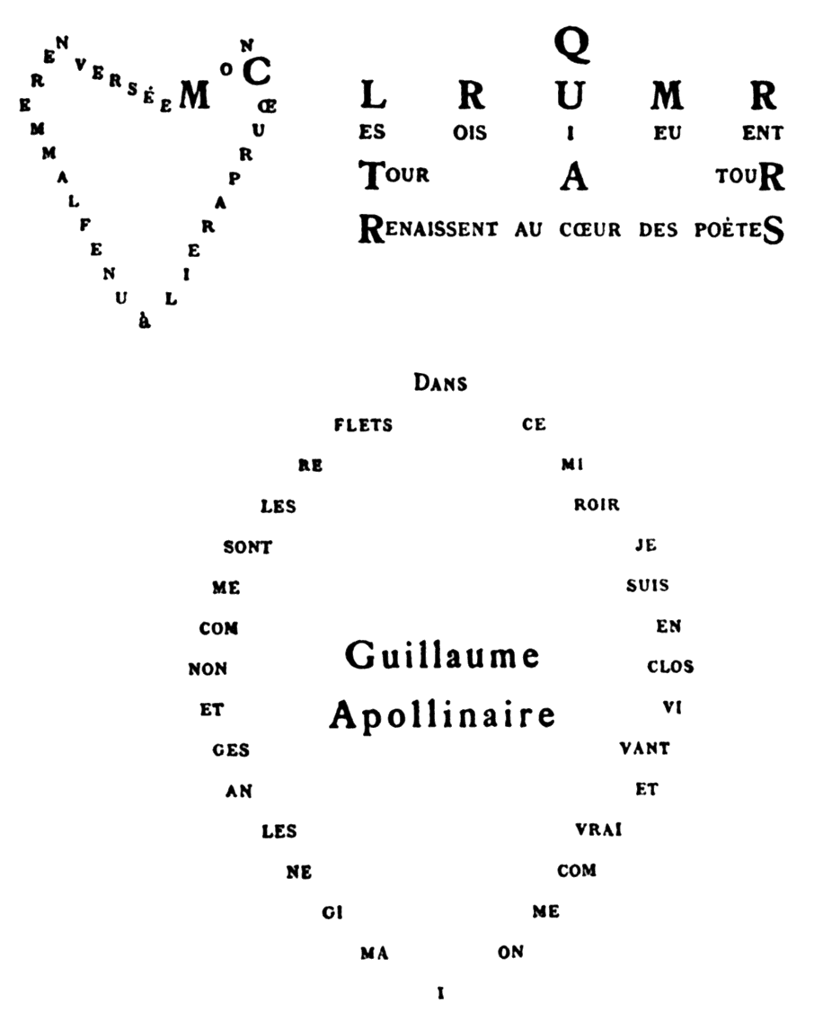
EXTRAS | VISUAL POETRY
GUILLAUME APOLLINAIRE | CŒUR COURONNE
ET MIROIR (1918)

Slide 10
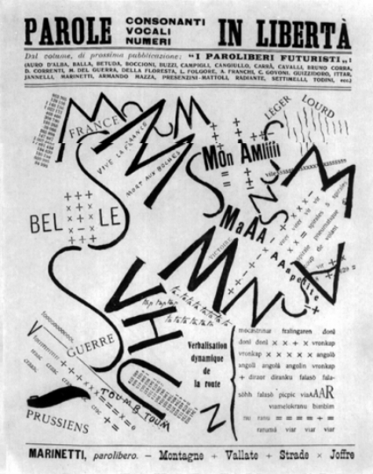
EXTRAS | VISUAL POETRY
F.T. MARINETTI
PAROLE IN LIBERTÀ
(1915)

Slide 11
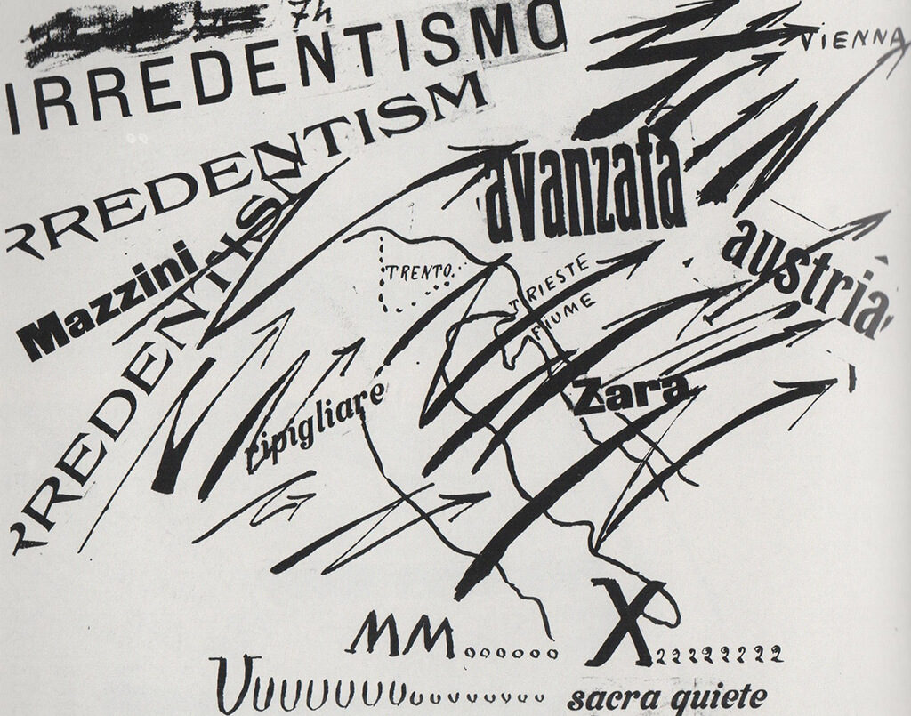
EXTRAS | VISUAL POETRY
F.T. MARINETTI | PAROLE IN LIBERTÀ (1914)

Slide 12
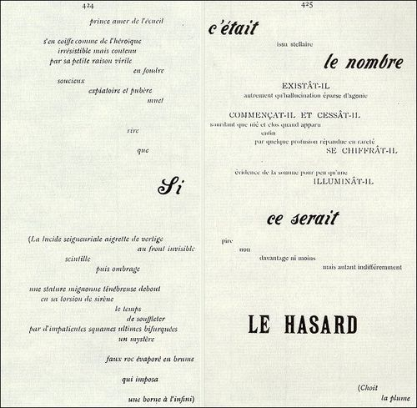
EXTRAS | VISUAL POETRY
S. MALLARMÉ
UN COUP DE DÉS
JAMAIS
N'ABOLIRA
LE HASARD
(1897)

Slide 13
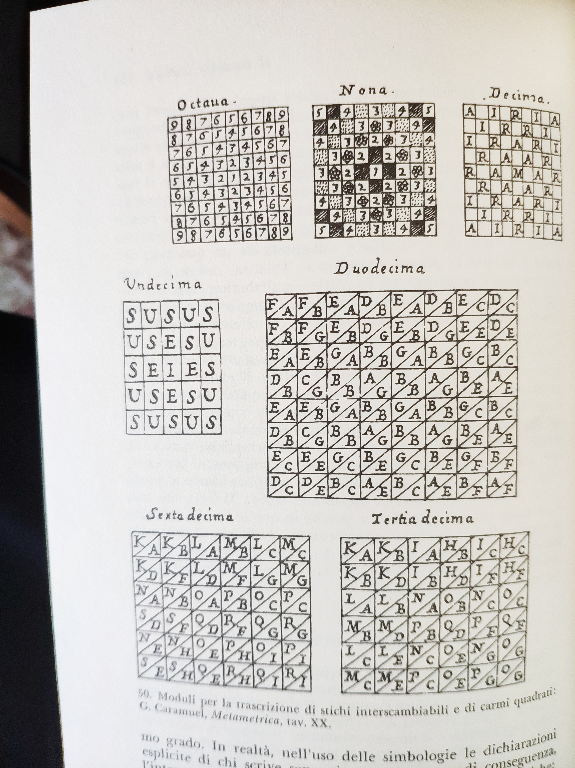
EXTRAS | VISUAL POETRY
G. CARAMUEL
MODULI PER LA
TRASCRIZIONE DI
STICHI
INTERSCAMBIABILI
E DI CARMI
QUADRATI
(1663)

Slide 14
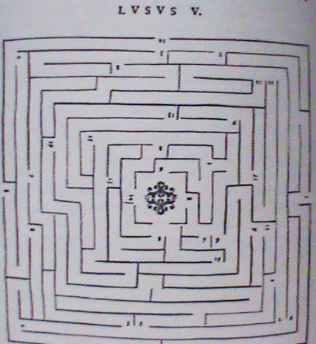
EXTRAS | VISUAL POETRY
P. F. PASSERINI
POESIA GEMATRICA
SENZA PAROLE
(1659)

Slide 15
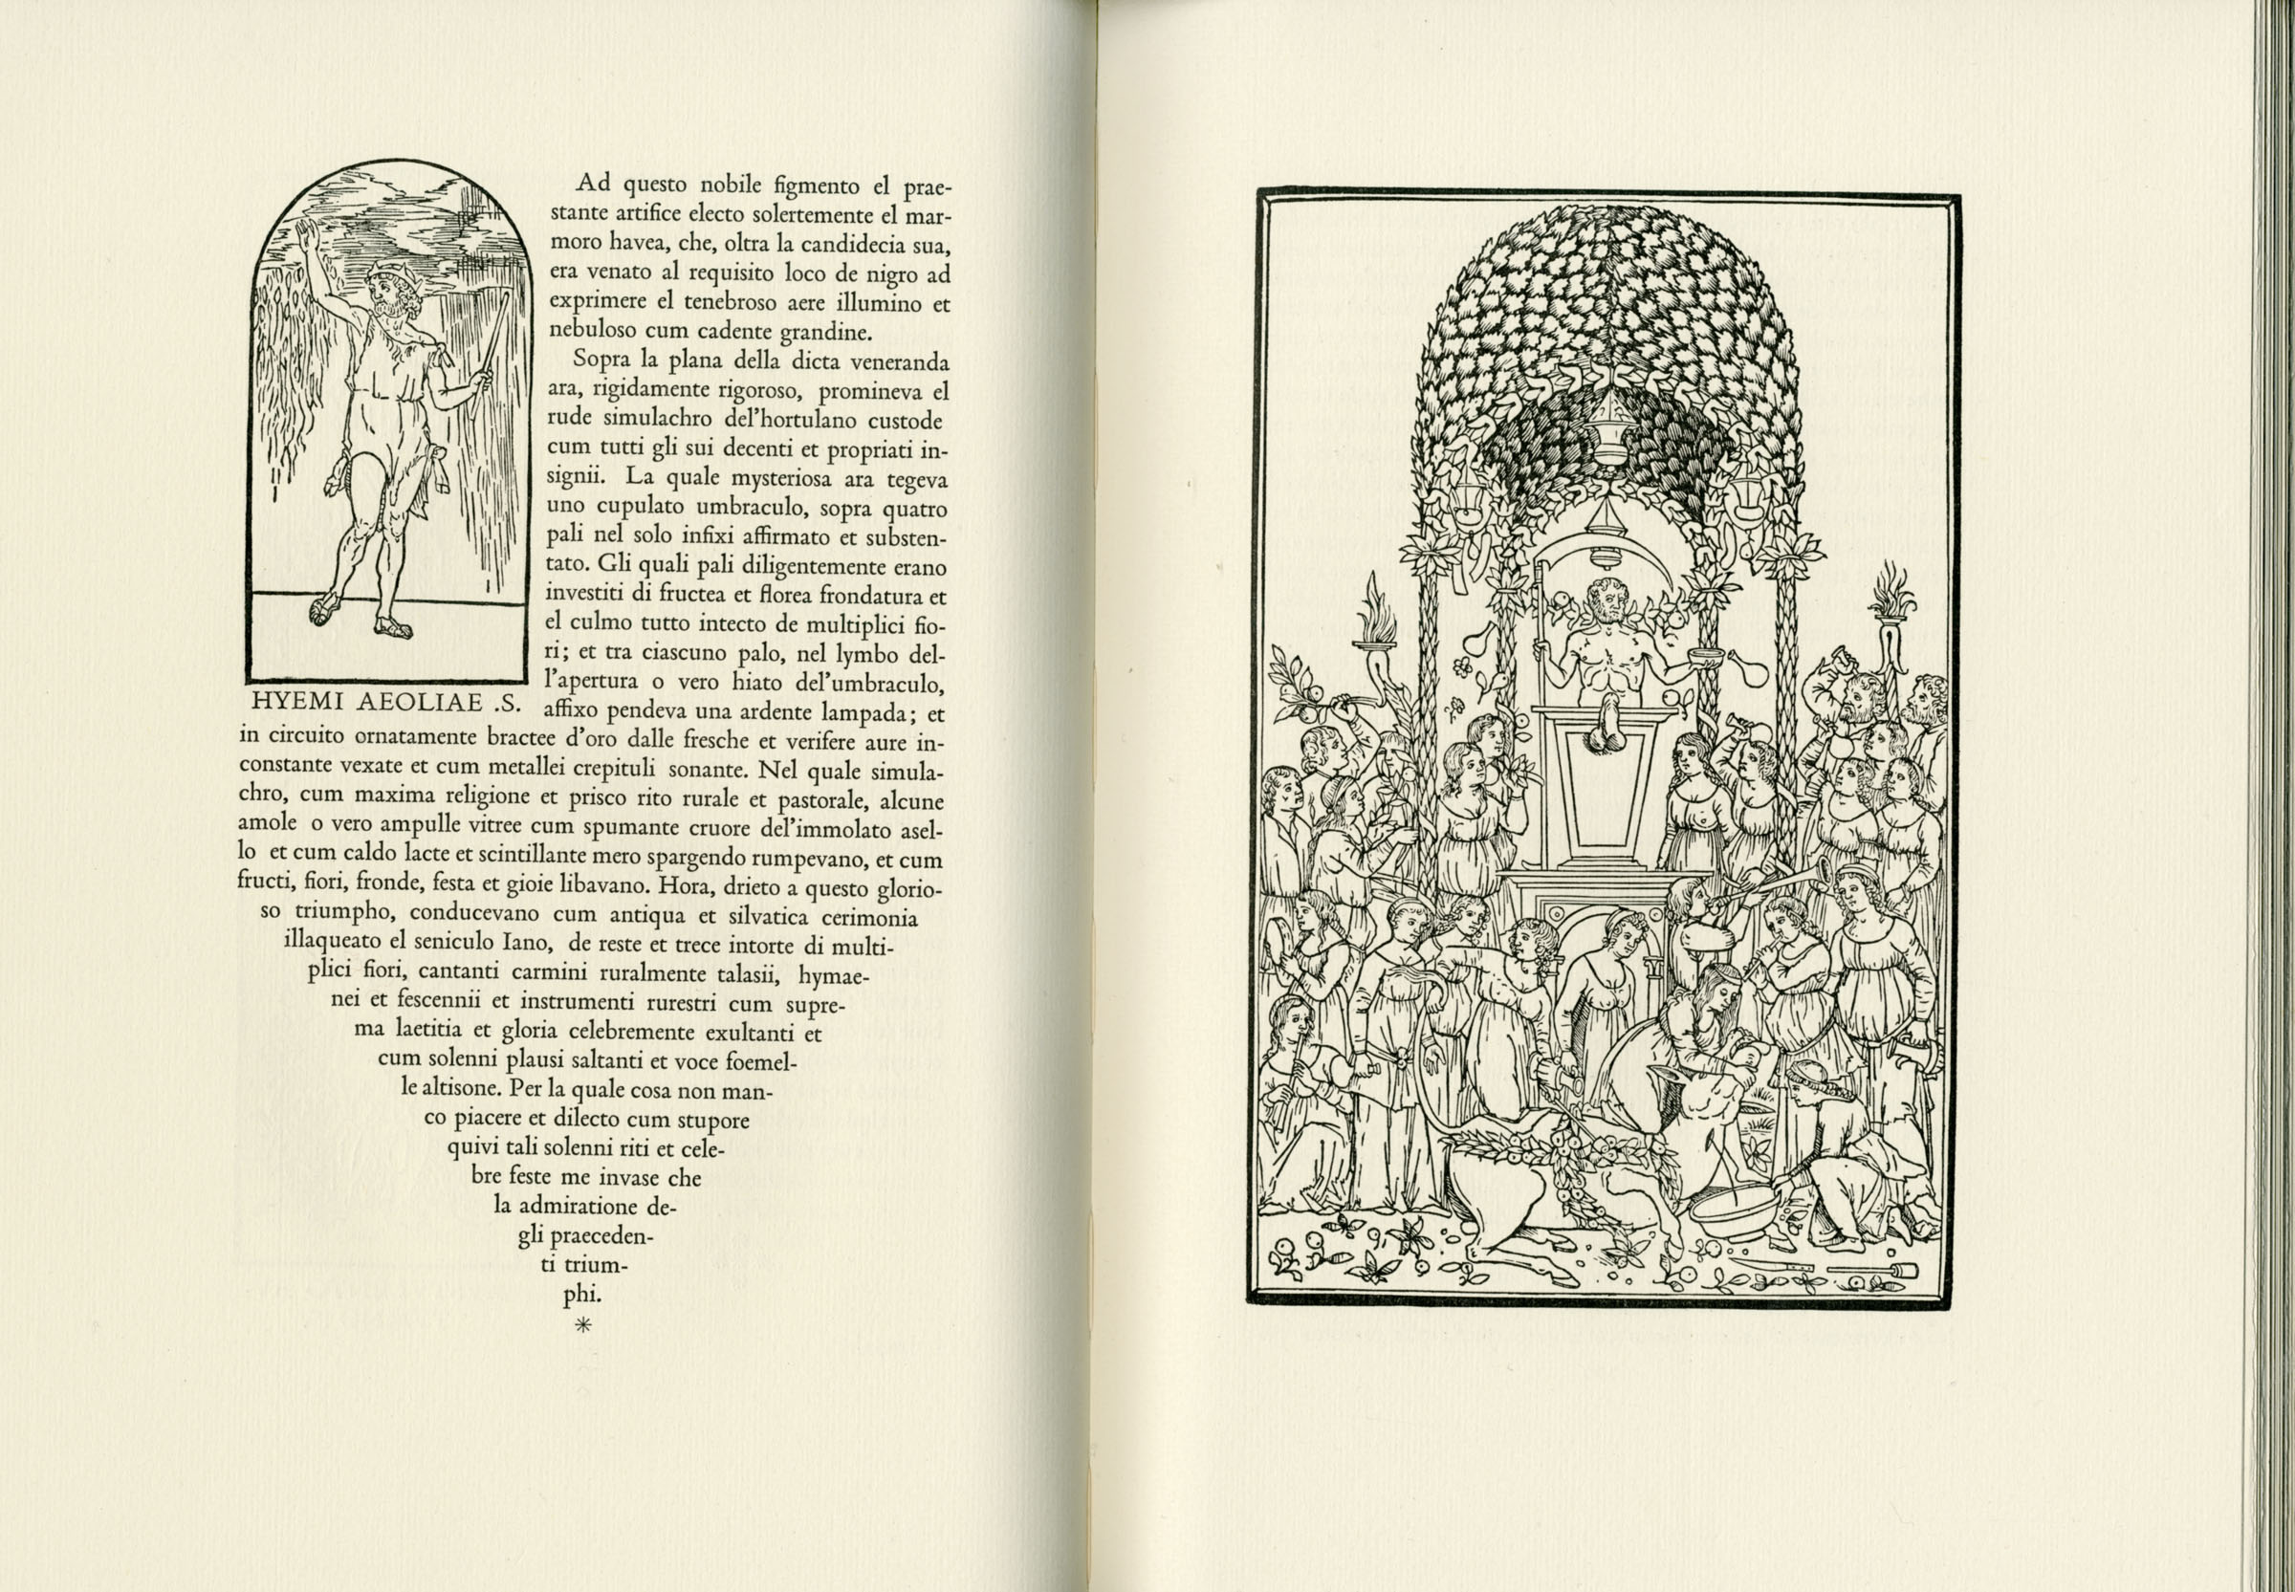
EXTRAS | VISUAL POETRY
FRANCESCO COLONNA | HYPNEROTOMACHIA POLIPHILI (1499)

Slide 16
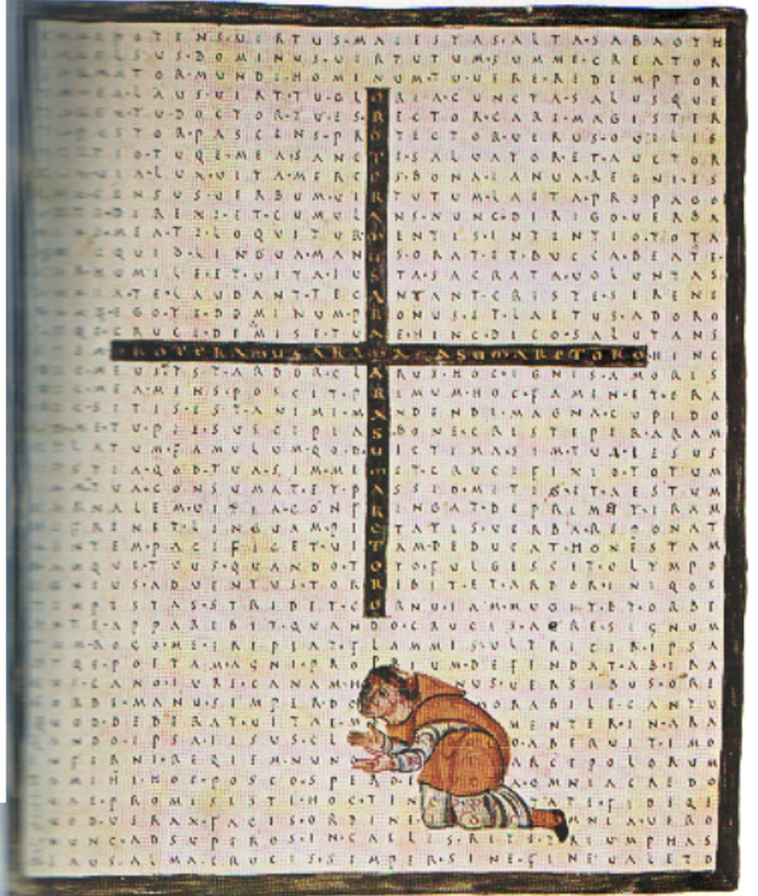
EXTRAS | VISUAL POETRY
RABANO MAURO
VERSI INTESSUTI
(810-814)

Slide 17
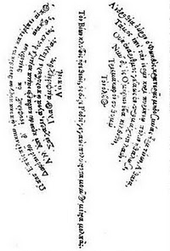
EXTRAS | VISUAL POETRY
SIMMIA DI RODI
TECHNOPAEGNION
RAFFIGURANTE
UNA SCURE
(III b.C.)

Slide 18
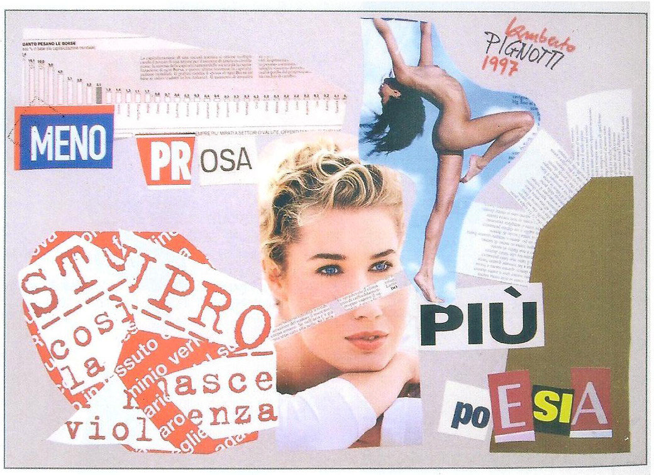
EXTRAS | VISUAL POETRY
LABERTO PIGNOTTI | MENO PROSA PIÙ POESIA (1997)

Slide 19
EXTRAS | VISUAL POETRY
UGO CARREGA
VISIONE CELESTE
(1992)

Slide 20
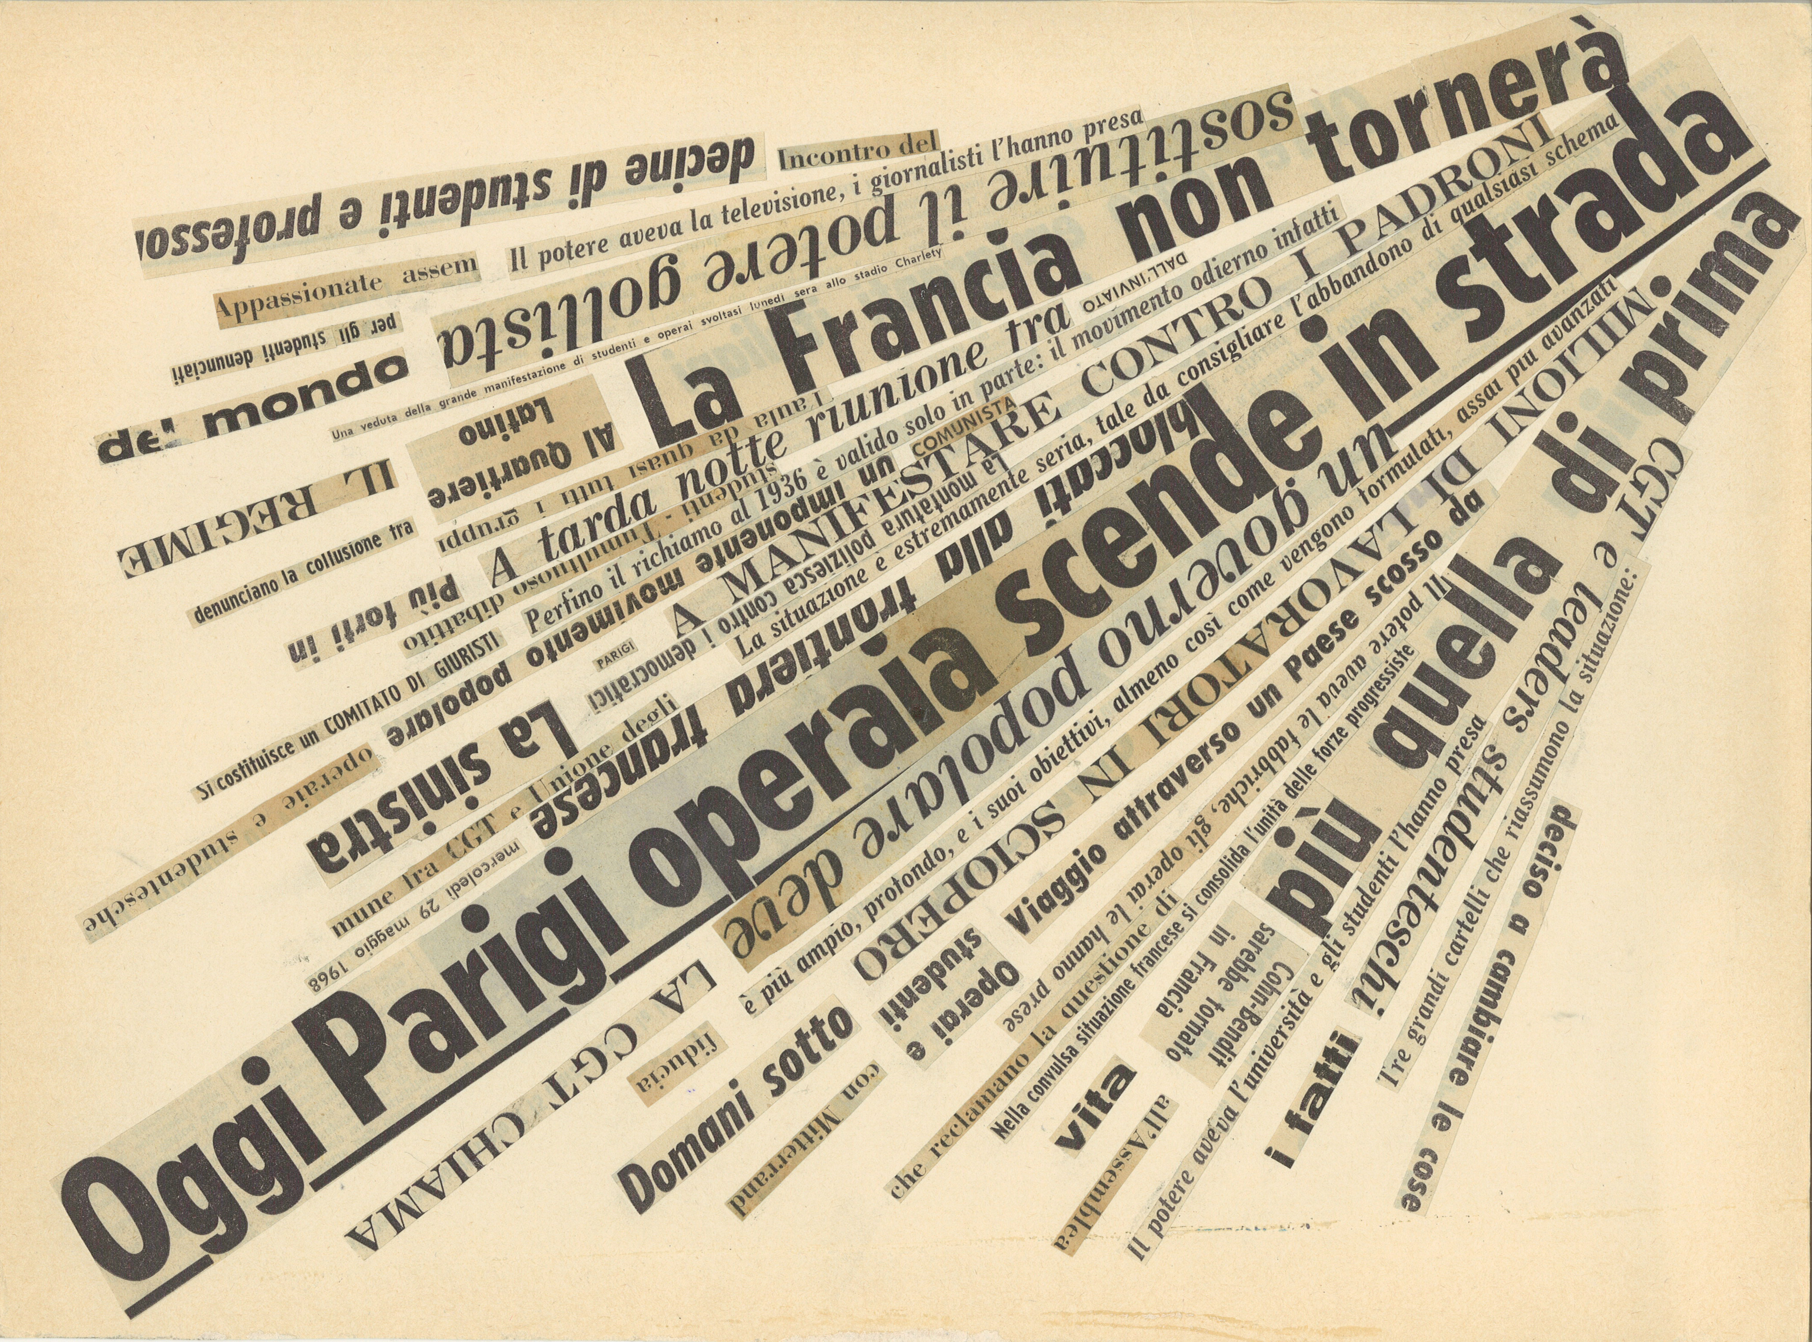
EXTRAS | VISUAL POETRY
NANNI BALESTRINI | OGGI PARIGI (1968)

Slide 21
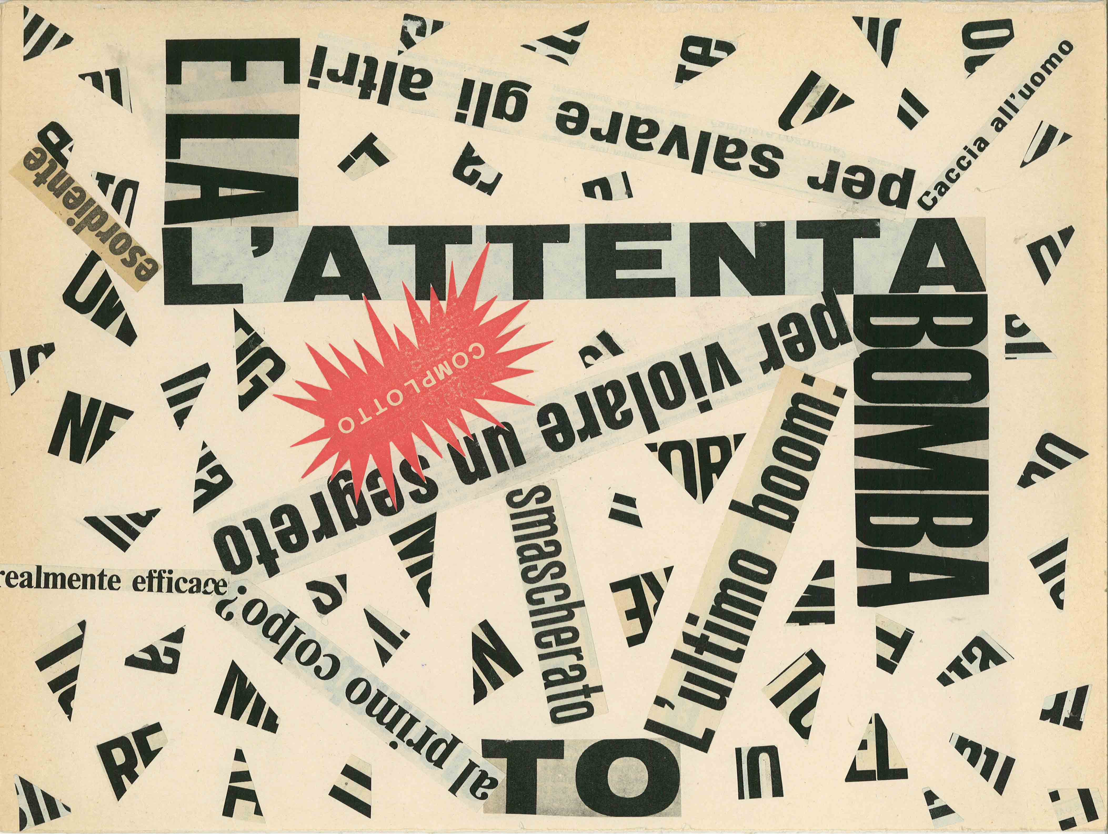
EXTRAS | VISUAL POETRY
NANNI BALESTRINI | COMPLOTTO (1965)

Slide 22
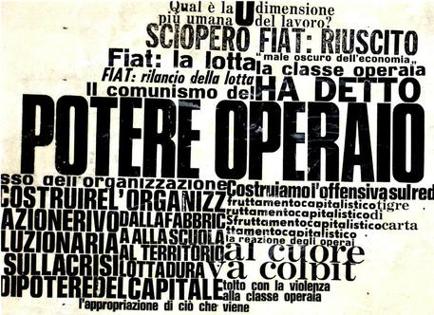
EXTRAS | VISUAL POETRY
NANNI BALESTRINI
POTERE OPERAIO
(1972)

Slide 23
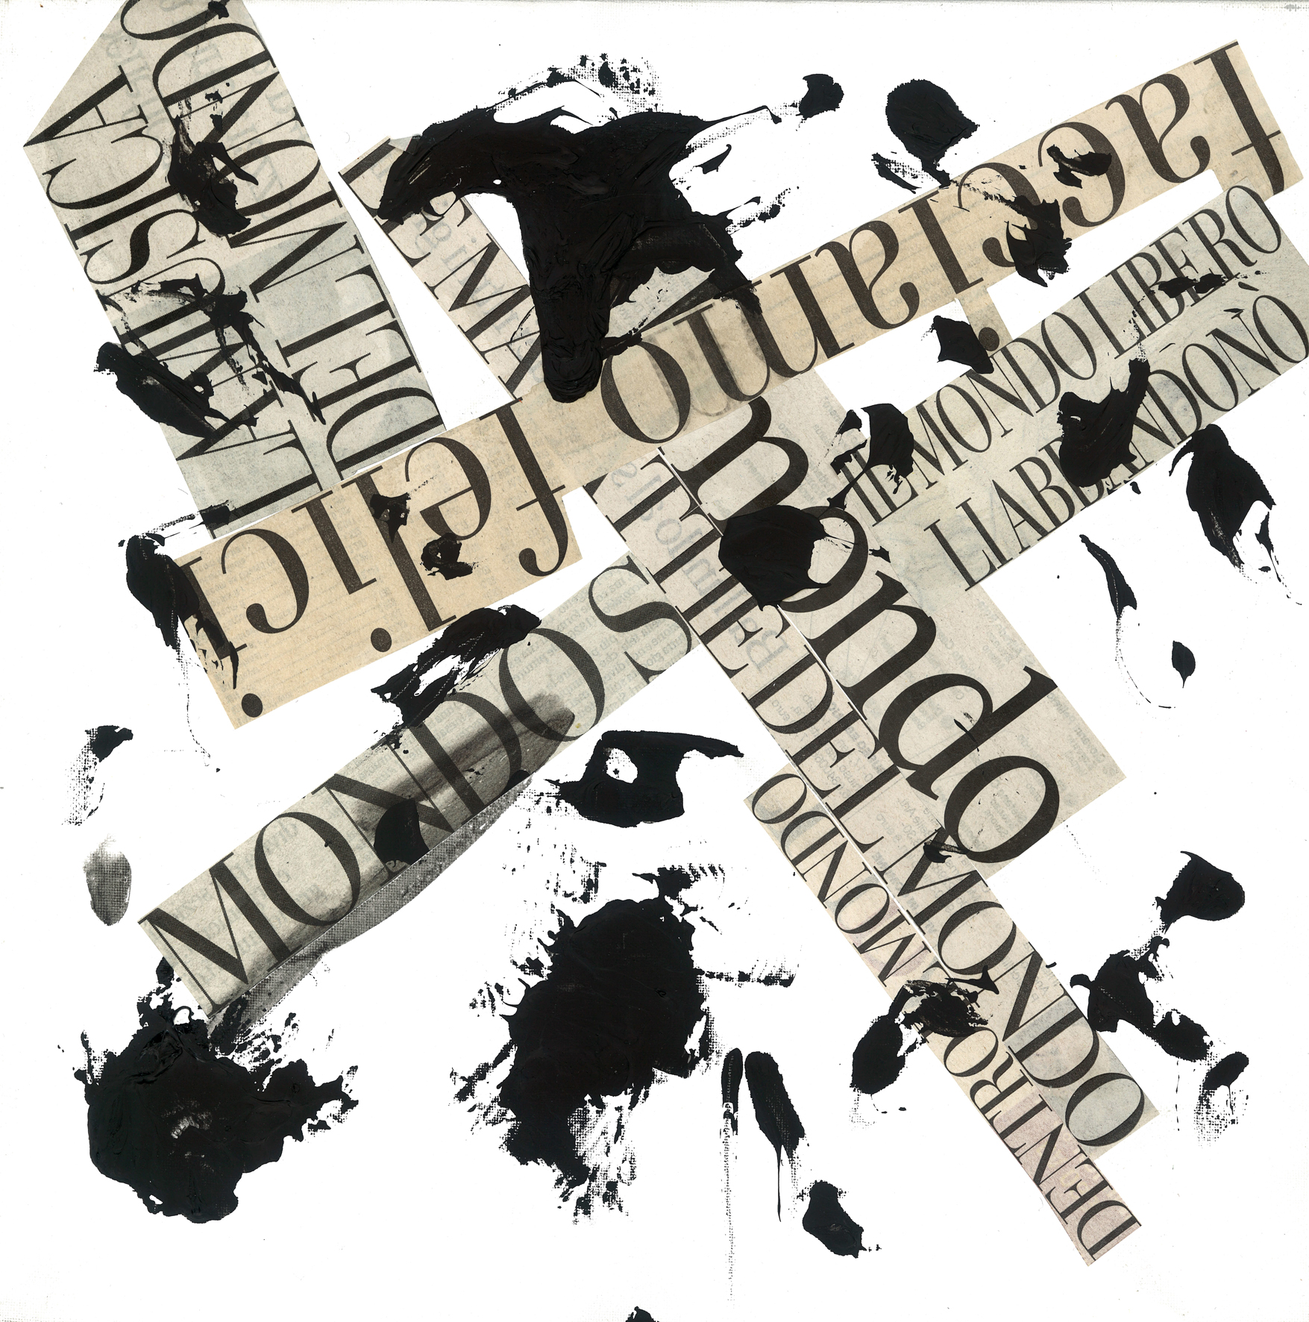
EXTRAS | VISUAL POETRY
NANNI BALESTRINI
MONDO
(2013-14)

Slide 24
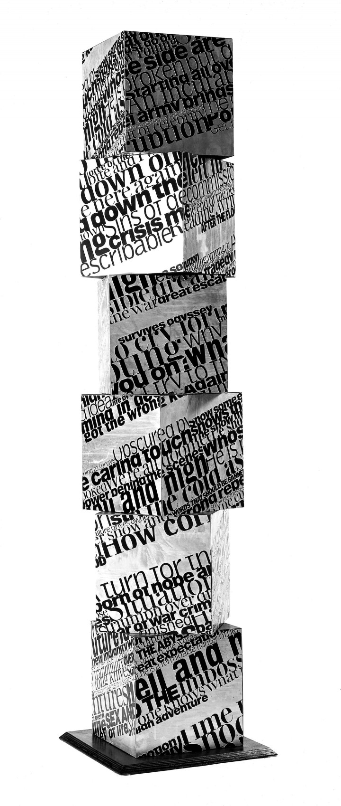
EXTRAS | VISUAL POETRY
NANNI BALESTRINI
COLONNE VERBALI,
HIGH AND HELL
(2001)

Slide 25
EXTRAS | VISUAL POETRY
Why is visual appearance important in digital media?
The digital environment is first and foremost visual
The text can be arranged in an unconventional way in space (become topographic) and in time (by animation)
The text can dialogue with other expressive codes (multimedia, intermedia)
The text can physically perform actions (eg links)

Slide 26
EXTRAS | VISUAL POETRY
Why is visual appearance important in digital media?
The text is no longer subordinated to speech
The text becomes an object to be both seen and used *
The space becomes a field of forces (play-area) *
* Cfr. Eugen Gomringer, “From Line to Constellation” (1954)
from Concrete Poetry: A World View, Indiana University Press, 1968

