Slide 1
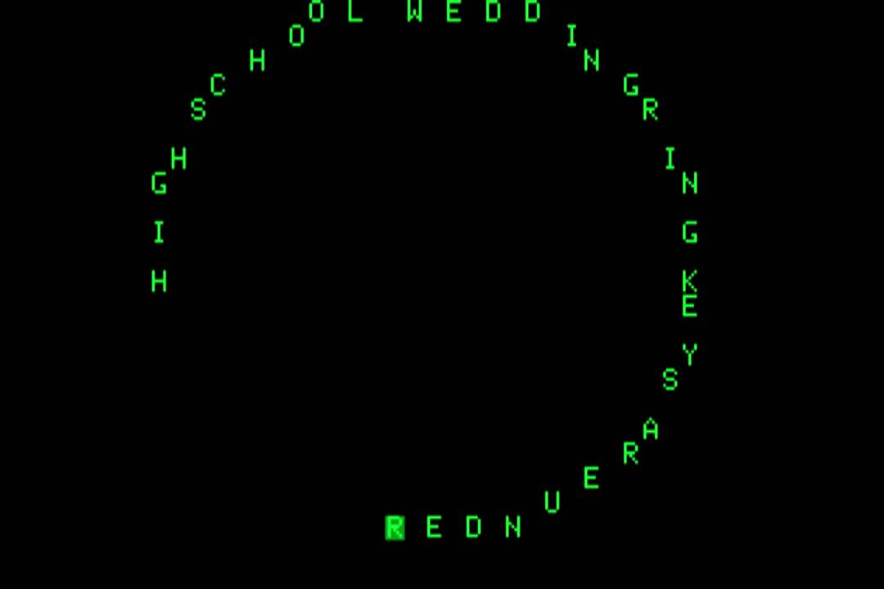
DIGITAL SEMIOTICS
Roberta Iadevaia
Notes:
1

Slide 2
INDEX
INTRODUCTION
What is Semiotics and what is it for
Different notions of sign:
Ferdinand de Saussure's Structural Semiotics Charles Peirce's Unlimited Semiosis Umberto Eco's Interpretive Semiotics Jean-Marie Klinkenberg's Cognitive Semiotics
Notes:
2

Slide 3
INDEX
EXAMPLES
Concrete Poetry
Eugen Gomringer: Schweigen
Animated Poetry
BpNichol: First Screening
Codeworks
Videoclip
Grandaddy: Jed's Other Poem (Beautiful Ground)
Notes:
3

Slide 4
INDEX
PLAN OF THE CONTENT
Jacques Jacques Fontanille's Generative Path of The Expression (level of practices)
Algirdas Julien Greimas's Semiotic Square
Algirdas Julien Greimas's Actantial Model
Alexander Galloway's Regimes of Signification of The Interfaces
Alexandra Saemmer's Interfacial Media Figures
Notes:
4

Slide 5
INTRODUCTION
WHAT IS SEMIOTICS?
Semiotics is the discipline that studies signs and the way they make sense (signification)
Thus semiotics is the study of sign process (semiosis)
WHAT IS IT FOR?
To analyze content, form and expression of every product composed of signs (books, films, web interfaces, works of electronic literature...)
Notes:
5

Slide 6
DIFFERENT NOTIONS OF SIGN
IN GENERAL
The sign is “something that refers to something else, to someone in some way” *
The sign is a discrete unit of meaning: a system composed of different elements
*M. Danesi, P. Perron, Analyzing Cultures: An Introduction and Handbook,
Indiana University Press, Bloomington 1999
Notes:
6

Slide 7
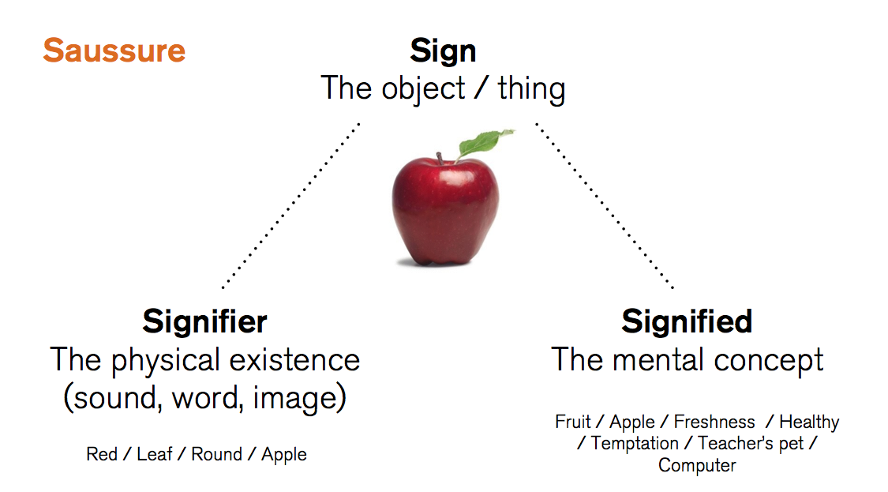
DIFFERENT NOTIONS OF SIGN
FERDINAND DE SAUSSURE
STRUCTURAL SEMIOTICS
Notes:
7

Slide 8
DIFFERENT NOTIONS OF SIGN
CHARLES PEIRCE | UNLIMITED SEMIOSIS
Notes:
8

Slide 9
DIFFERENT NOTIONS OF SIGN
UMBERTO ECO | INTERPRETIVE SEMIOTICS
Interpretive Semiotics questions ontological Structuralism
The construction of the meaning is played within the dialectical process activating between the rhetorical-textual structures and the reader's interpretation strategies (“principle of interpretative cooperation” >> Lector in fabula)
Notes:
9

Slide 10
DIFFERENT NOTIONS OF SIGN
A CLARIFICATION.
THE NOTION OF “TEXT” IN SEMIOTICS
TEXT >> any semiotic object with a particular structure aiming to obtain a particular series of communicative purposes
Text can consist of different media forms (visual text, audiovisual text...)
Notes:
10

Slide 11
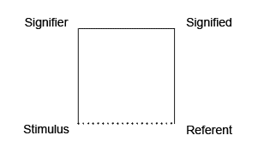
DIFFERENT NOTIONS OF SIGN
JEAN-MARIE KLINKENBERG
COGNITIVE SEMIOTICS
STIMULUS = a physical manifestation of the abstract model of the signifier
Notes:
11

Slide 12
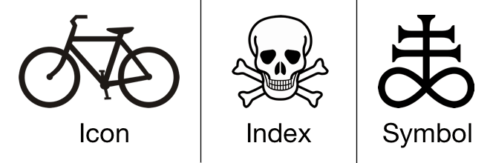
DIFFERENT NOTIONS OF SIGN
CHARLES PEIRCE | SUBDIVISION OF SIGNS
Icon >> similarity relationship between signifier and referent
Index >> direct relationship between signifier and referent
Symbol >> arbitrary relationship between signifier and referent
Notes:
12

Slide 13
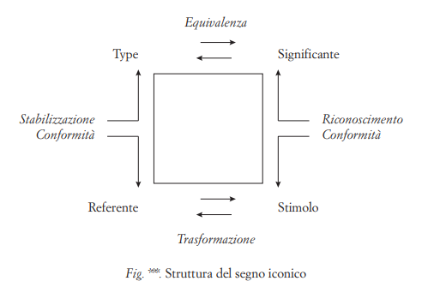
DIFFERENT NOTIONS OF SIGN
JEAN-MARIE KLINKENBERG
COGNITIVE SEMIOTICS
Notes:
13

Slide 14
DIFFERENT NOTIONS OF SIGN
JEAN-MARIE KLINKENBERG
COGNITIVE SEMIOTICS
Focus on the raw material of signs
Morgue
Reserve of stabilized (conventional) types >>
"good forms" (Gestalten) or profondeur de dispositif (Philippe Bootz)
Notes:
14

Slide 15
DIFFERENT NOTIONS OF SIGN
JEAN-MARIE KLINKENBERG
COGNITIVE SEMIOTICS
Morgue
Cultural code (fonts prohibited in certain contexts)
Linguistic code (the set of words)
Plastic code (colors, shapes, texture of the letters)
Typography is a multi-code system.
The code that prevails (semiotic decision) depends on our goal and our interpretation (>> profondeur de dispositif)
Notes:
15

Slide 16
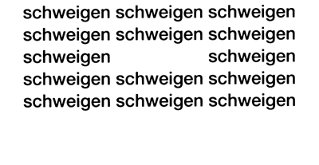
EXAMPLE 1. CONCRETE POETRY
EUGEN GOMRINGER | SCHWEIGEN
Notes:
16

Slide 17
EXAMPLE 1. CONCRETE POETRY
EUGEN GOMRINGER | SCHWEIGEN
All semiotic codes possess: a grammar (the association rules of the signifier's system)
All grammars are constituted by a vocabulary (the set of elements present in the code), and a syntax (the rules for the association of these elements)
Vocabulary >> paradigmatic axis
Syntax >> syntagmatic axis
Notes:
17

Slide 18
EXAMPLE 1. CONCRETE POETRY
EUGEN GOMRINGER | SCHWEIGEN
Gomringer's definition of constellation
Our languages are on the road to formal simplification, abbreviated, restricted forms of language are emerging. The content of a sentence is often conveyed in a single word. Longer statements are often represented by small groups of letters. Moreover, there is a tendency among languages for the many to be replaced by a few which are generally valid. Does this restricted and simplified use of language and writing mean the end of poetry? Certainly not. Restriction in the best sense-concentration and simplification- is the very essence of poetry. The constellation is the simplest possible kind of configuration in poetry, which has for its basic unit the word, it encloses a group of words as if it were drawing stars together to form a cluster.
Eugen Gomringer, “From Line to Constellation” (1954)
from Concrete Poetry: A World View, Indiana University Press, 1968
Notes:
18

Slide 19
EXAMPLE 1. CONCRETE POETRY
EUGEN GOMRINGER | SCHWEIGEN
So, in Concrete Poetry...
the basic unit remains the word (linguistic code),
but the grammar is not based on syntactic rules, but on plastic ones >>
Linguistic vocabulary && plastic syntax
Notes:
19

Slide 20
EXAMPLE 1. CONCRETE POETRY
EUGEN GOMRINGER | SCHWEIGEN
Linguistic code: idea of repetition...
Plastic code: a frame, a tomb...
Focus on the raw material of language (visual and plastic aspect of the linguistic code) will lead to pay attention also to the supports that convey poetry...
Notes:
20

Slide 21
EXAMPLE 2. ANIMATED POETRY
BARRIE PHILIPP NICHOL (bpNichol)
FIRST SCREENING (1984)
The first digital anthology of poems
Made on Apple IIe
Programmed work (Apple BASIC)
As the result depends on the technical execution context, it will not always be identical (lability)
Autor of programmed work is a meta-author and is in the same situation as the reader
Intentio auctoris is problematized
Lability is reproductive >> meta-reading
Notes:
21

Slide 22
EXAMPLE 2. ANIMATED POETRY
BARRIE PHILIPP NICHOL (bpNichol)
FIRST SCREENING (1984)
Notes:
22

Slide 23
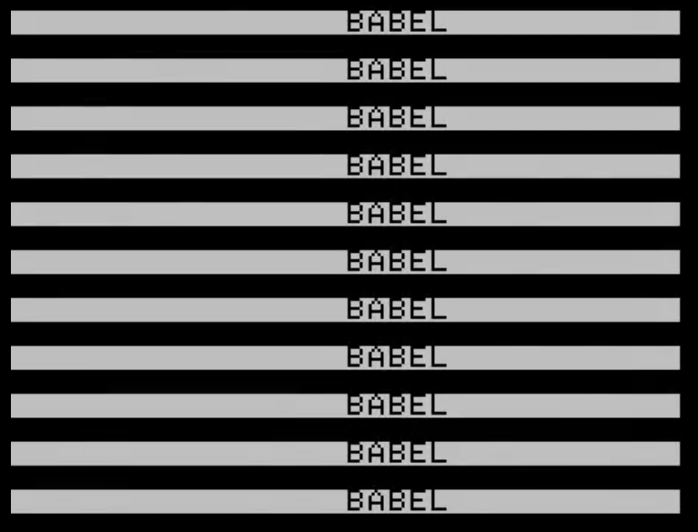
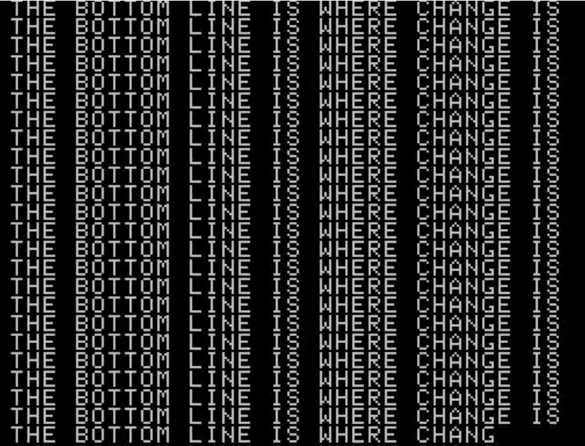
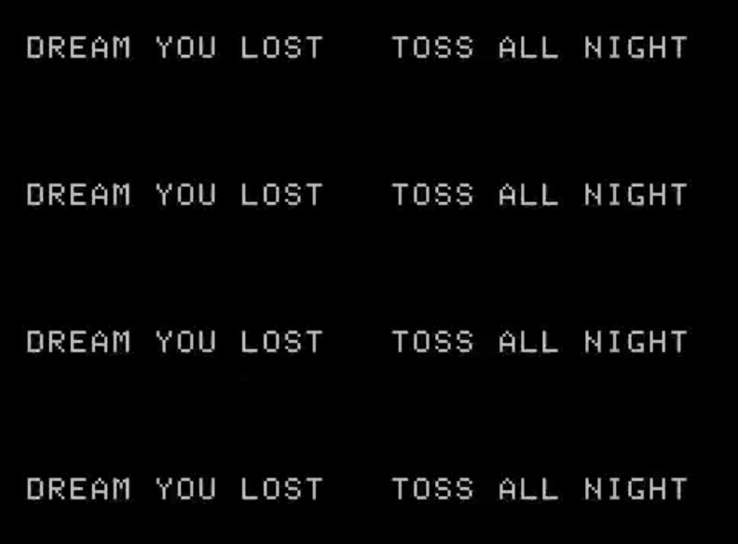
EXAMPLE 2. ANIMATED POETRY
BARRIE PHILIPP NICHOL (bpNichol)
FIRST SCREENING (1984)
Repetition (rhetorical figure)
EPIZEUXIS repetition of a word or phrase in immediate succession
Notes:
23

Slide 24
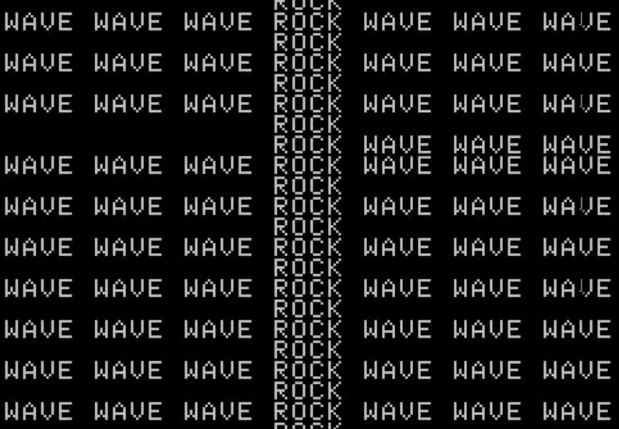
EXAMPLE 2. ANIMATED POETRY
BARRIE PHILIPP NICHOL (bpNichol)
FIRST SCREENING (1984)
Repetition (rhetorical figure)
DIACOPE repetition of a word with one
or two intervening words
Notes:
24

Slide 25
EXAMPLE 2. ANIMATED POETRY
BARRIE PHILIPP NICHOL (bpNichol)
FIRST SCREENING (1984)
Repetition >> rhetorical effects
To achieve Calligrams (link to visual and concrete poetry)
To visually reinforce the linguistic meaning
To reach a paradoxical effect
Notes:
25

Slide 26
EXAMPLE 2. ANIMATED POETRY
BARRIE PHILIPP NICHOL (bpNichol)
FIRST SCREENING (1984)
Appearance of the text:
Lateral sliding
print tradition
Flashing on the same line poetry
Vertical scrolling film conventions
Notes:
26

Slide 27
EXAMPLE 2. ANIMATED POETRY
BARRIE PHILIPP NICHOL (bpNichol)
FIRST SCREENING (1984)
Appearance of the text: focus on permutation
Syntactic animation: the syntactic function of the same word changes due to the movement of the word
Animation works simultaneously with chrono-syntax (the syntactic function of words is given by their order of appearance, as in the oral discourse) and topo-syntax (the syntactic function is determined by the position of words in space, as in the written text)
Notes:
27

Slide 28
EXAMPLE 2. ANIMATED POETRY
BARRIE PHILIPP NICHOL (bpNichol)
FIRST SCREENING (1984)
Appearance of the text
The movement assumes the syntactic function traditionally carried out by the verb, that is, it makes the words perform an action
Notes:
28

Slide 29
EXAMPLE 2. ANIMATED POETRY
BARRIE PHILIPP NICHOL (bpNichol)
FIRST SCREENING (1984)
Appearance of the text
Text has become performative (it does what it says)
Space has become choreographic (words are free to move and perform, like dancers or actors)
Notes:
29

Slide 30
EXAMPLE 2. ANIMATED POETRY
BARRIE PHILIPP NICHOL (bpNichol)
FIRST SCREENING (1984)
Appearance of the text
Linguistic signs have also visual and plastic values
Intermedia* : continuous and ambiguous circulation between different semiotic systems
* Wilton Azevedo, Philadepho Menezes, 1998
Notes:
30

Slide 31
EXAMPLE 2. ANIMATED POETRY
BARRIE PHILIPP NICHOL (bpNichol)
FIRST SCREENING (1984)
Appearance of the text
Notes:
31

Slide 32
EXAMPLE 2. ANIMATED POETRY
BARRIE PHILIPP NICHOL (bpNichol)
FIRST SCREENING (1984)
Appearance of the text
Physical behavior of the device is projected on the linguistic meaning >> material metaphors *
* N. Katherine Hayles, Writing Machines, 2002
Notes:
32

Slide 33
EXAMPLE 2. ANIMATED POETRY
BARRIE PHILIPP NICHOL (bpNichol)
FIRST SCREENING (1984)
Appearance of the text
Technotext * : any literary work that interrogates the inscription technology that produces it
First Screening is a technotext both because it reflects on the differences with print, and because it plays with the opacity of the electronic medium
* N. Katherine Hayles, Writing Machines, 2002
Notes:
33

Slide 34
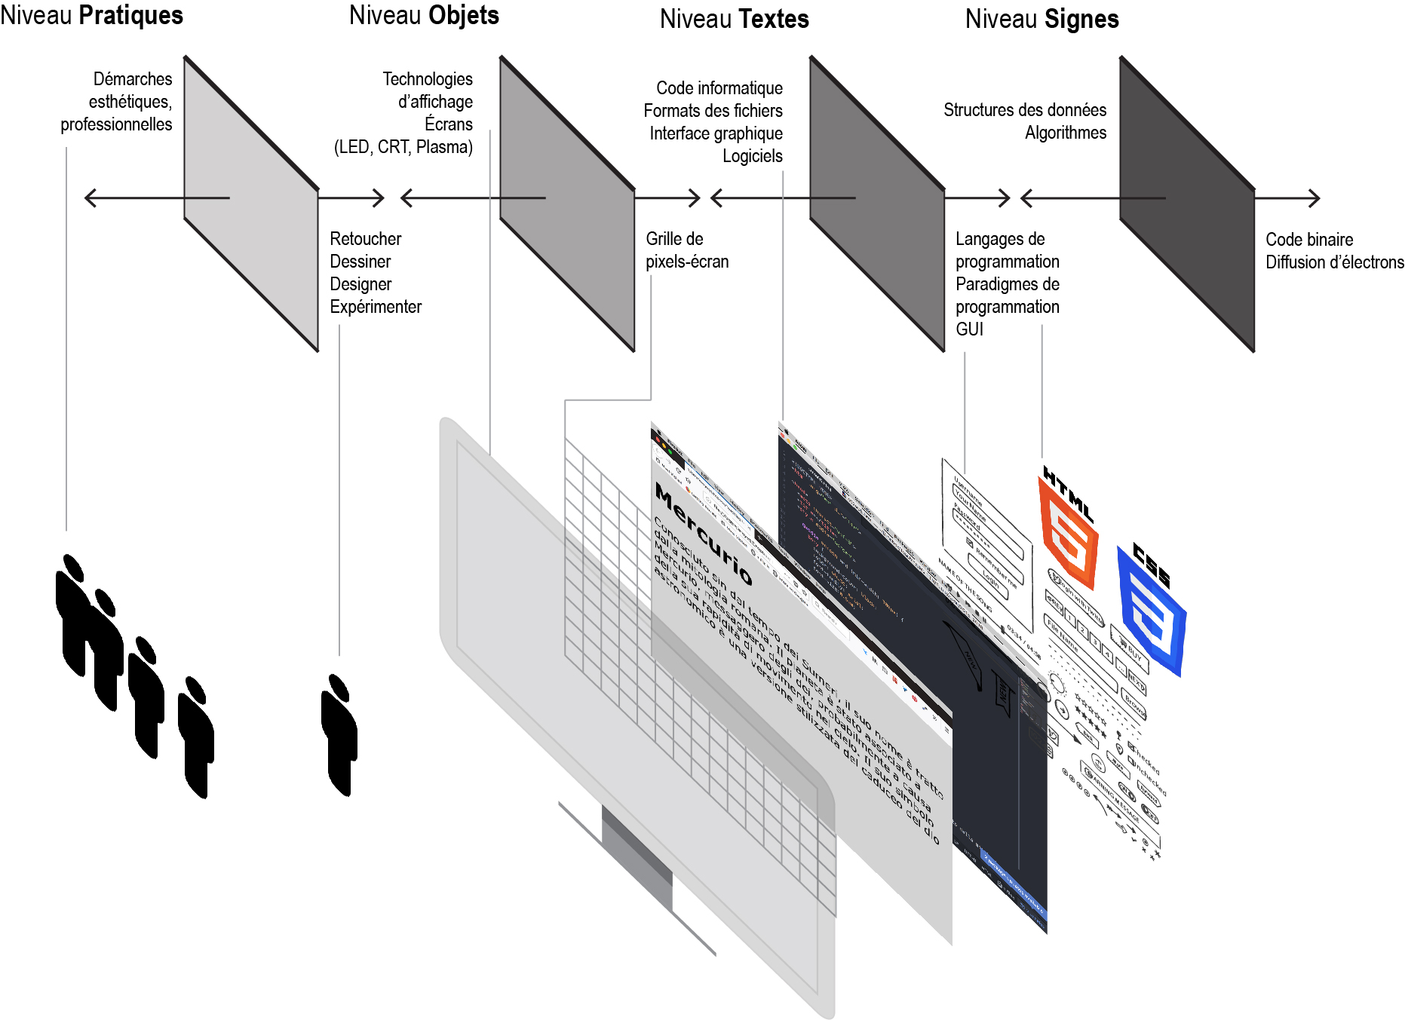
EXAMPLE 2. ANIMATED POETRY
JACQUES JACQUES FONTANILLE
THE GENERATIVE PATH OF THE EXPRESSION
Notes:
34

Slide 35
EXAMPLE 2. ANIMATED POETRY
JACQUES JACQUES FONTANILLE
THE GENERATIVE PATH OF THE EXPRESSION
Any digital interface has several levels as:
programming and marking languages
algorithms and data structure
Reading the computer code of a digital work could be useful both to understand the functioning logic of the work itself, both because this level may contain things that do not appear on screen, but which may be relevant for expressive purposes
Notes:
35

Slide 36
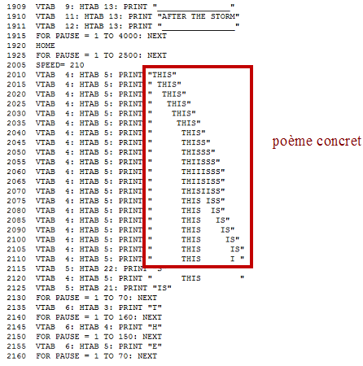
EXAMPLE 2. ANIMATED POETRY
BARRIE PHILIPP NICHOL (bpNichol)
FIRST SCREENING (1984)
Notes:
36

Slide 37
EXAMPLE 2. ANIMATED POETRY
BARRIE PHILIPP NICHOL (bpNichol)
FIRST SCREENING (1984)
Computer code can possess an aesthetic dimension (it is a language)
Codework * : a work that uses computer code not only for functional reasons, but also for aesthetic and rhetoric purposes
* Alan Sondheim, 2001
Notes:
37

Slide 38
EXAMPLE 3. CODEWORK
PURE CODE >> texts executable by the machine
Pandora's Box Invocation, remake by Angie Winterbottom (2000) *
If light were dark and dark were light
The moon a black hole in the blaze of night
A raven's wing as bright as tin
Then you, my love, would be darker than sin
if ((light eq dark) && (dark eq light) \
&& ($blaze_of_night{moon} == black_hole)
&& ($ravens_wing{bright} == $tin{bright})){
my $love = $you = $sin{darkness} + 1; };
*http://www.foo.be/docs/tpj/issues/vol5_1/tpj0501-0012.html
Notes:
38

Slide 39
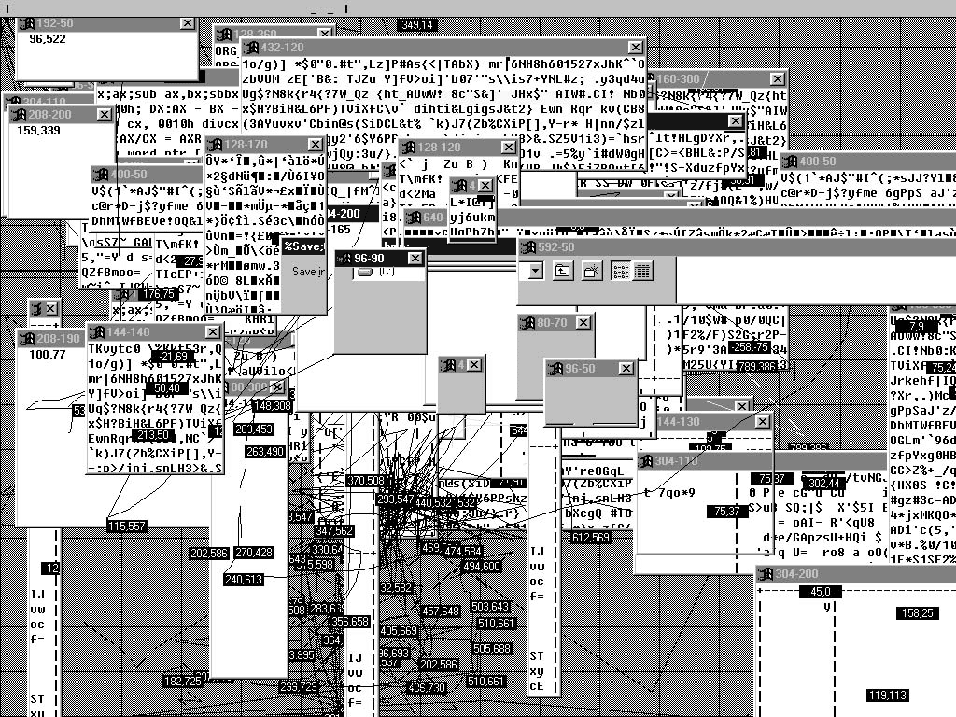
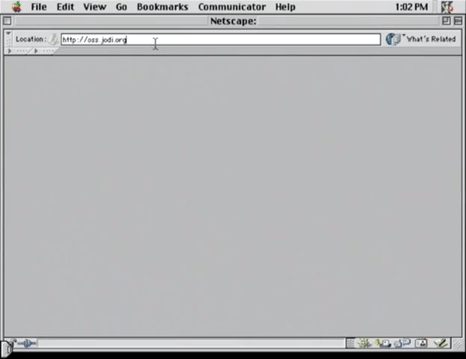
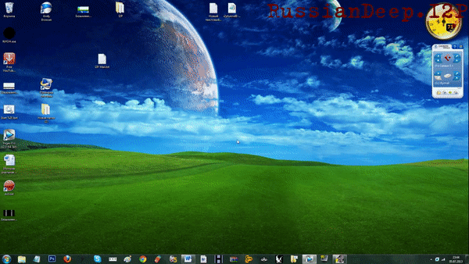
EXAMPLE 3. CODEWORK
PURE CODE >> texts executable by the machine
JODI (Joan Heemskerk e Dirk Paesmans) | OSS/**** (1998)
Notes:
39

Slide 40
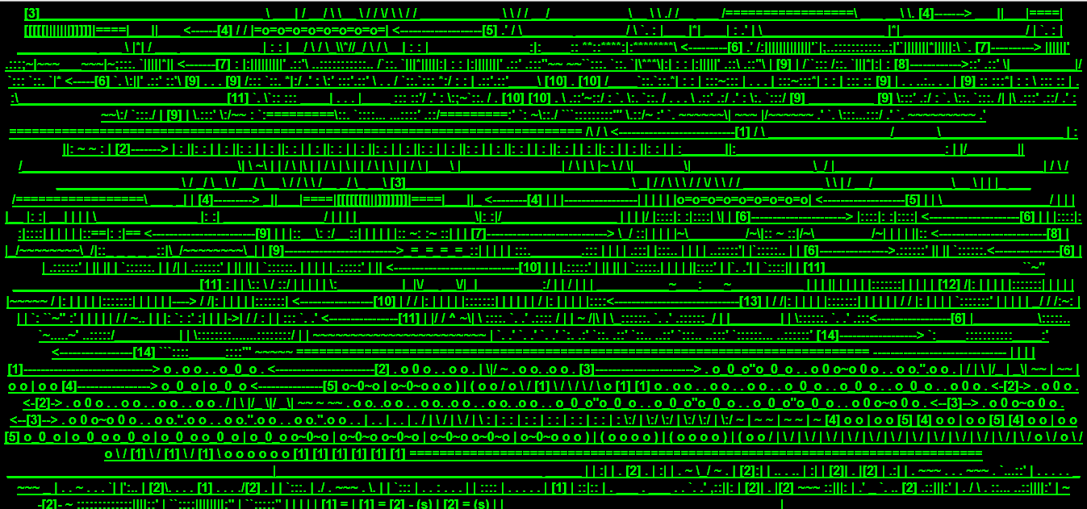
EXAMPLE 3. CODEWORK
PURE CODE >> texts executable by the machine
JODI's HOMEPAGE
Notes:
40

Slide 41
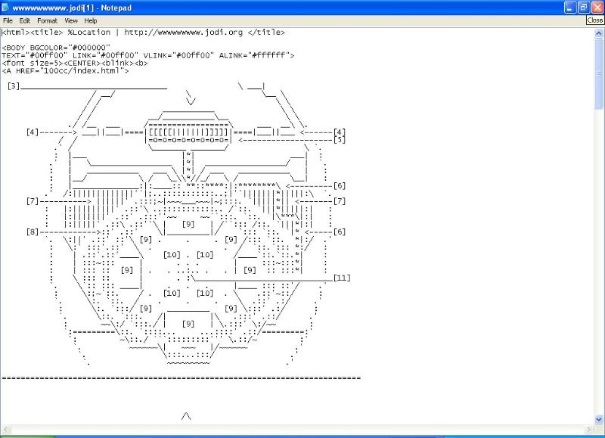
EXAMPLE 3. CODEWORK
PURE CODE >> texts executable by the machine
JODI's HOMEPAGE wwwwwwwww.jodi.org
Notes:
41

Slide 42
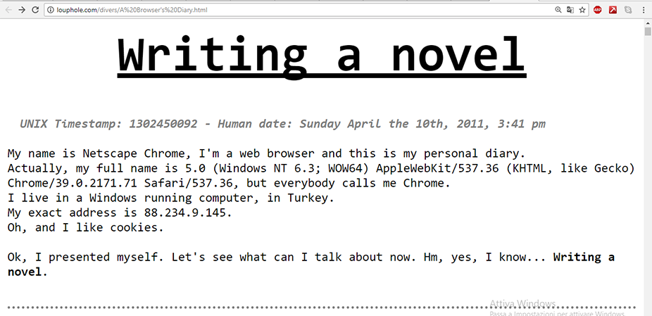
EXAMPLE 3. CODEWORK
BROKE CODE >> texts NOT executable
A Web Browser's Diary by Bilgé Kimyonok (2014) *
* http://louphole.com/divers/A%20Browser's%20Diary.html
Notes:
42

Slide 43
EXAMPLE 3. CODEWORK
Computer code as a literary/artistic medium
An image is just as much a result of the various codes that interpret it, as it is the result of authorial intention or audience perception *
Experimental dysfunctionality >> A systematic and programmatic artistic research focused on the anomalies of computational systems aimed at critically reflect on new media **
* Brett Stalbaum (1998)
** Marie-Laure Ryan (2010)
Notes:
43

Slide 44
EXAMPLE 4. VIDEOCLIP
GRANDADDY | JED'S OTHER POEM (BEAUTIFUL GROUND) (2000)
Notes:
44

Slide 45
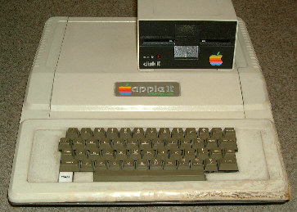
EXAMPLE 4. VIDEOCLIP
GRANDADDY | JED'S OTHER POEM (BEAUTIFUL GROUND) (2000)
APPLE II (1977)
Huge influence on home computers (dawn of mass dissemination of IT)
Important for Italian electronic literature (it was used by Enrico Colombini for the first Italian text adventure Avventura nel castello, in 1982)
Notes:
45

Slide 46
EXAMPLE 4. VIDEOCLIP
GRANDADDY | JED'S OTHER POEM (BEAUTIFUL GROUND) (2000)
About the format
It is a videoclip and not a programmed work because:
music starts before the execution of the program (when the word “run” appears)
there are not progressive non-synchronizations between code and audiovisual output
Notes:
46

Slide 47
EXAMPLE 4. VIDEOCLIP
GRANDADDY | JED'S OTHER POEM (BEAUTIFUL GROUND) (2000)
About the computer code
It is referred as an actor (anthropomorphism )
Notes:
47

Slide 48
EXAMPLE 4. VIDEOCLIP
GRANDADDY | JED'S OTHER POEM (BEAUTIFUL GROUND) (2000)
About the computer code
Mise en abyime of computer science in videoclip: the video represents the context in which the fruition of digital works take place (screen, device, reader's place)
Notes:
48

Slide 49
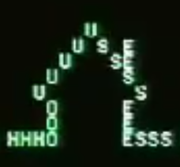
EXAMPLE 4. VIDEOCLIP
GRANDADDY | JED'S OTHER POEM (BEAUTIFUL GROUND) (2000)
About the semiotic codes
Cursor icon >> computer code or plastic code
Words >> linguistic code
Song >> music code
Calligrams >> visual code
Notes:
49

Slide 50
EXAMPLE 4. VIDEOCLIP
GRANDADDY | JED'S OTHER POEM (BEAUTIFUL GROUND) (2000)
About the semiotic codes
Animations >> temporal semiotics
Computer code >> computer code
Closing credits, editing >> video/movie code
Apple II >> cultural code
Notes:
50

Slide 51
EXAMPLE 4. VIDEOCLIP
GRANDADDY | JED'S OTHER POEM (BEAUTIFUL GROUND) (2000)
About the semiotic effects generated by animation
Intermittent cursor >> waiting for an action
Notes:
51

Slide 52
EXAMPLE 4. VIDEOCLIP
GRANDADDY | JED'S OTHER POEM (BEAUTIFUL GROUND) (2000)
About the semiotic effects generated by animation
Notes:
52

Slide 53
EXAMPLE 4. VIDEOCLIP
GRANDADDY | JED'S OTHER POEM (BEAUTIFUL GROUND) (2000)
About the semiotic effects generated by animation
Psychological effect due to the association of the linguistic meaning to the movement
Notes:
53

Slide 54
EXAMPLE 4. VIDEOCLIP
GRANDADDY | JED'S OTHER POEM (BEAUTIFUL GROUND) (2000)
About the semiotic effects generated by animation
Writing space: from typographic (linear) to choreographic
Notes:
54

Slide 55
EXAMPLE 4. VIDEOCLIP
GRANDADDY | JED'S OTHER POEM (BEAUTIFUL GROUND) (2000)
About the semiotic effects generated by animation
Notes:
55

Slide 56
EXAMPLE 4. VIDEOCLIP
GRANDADDY | JED'S OTHER POEM (BEAUTIFUL GROUND) (2000)
About the semiotic effects generated by animation
Notes:
56

Slide 57
EXAMPLE 4. VIDEOCLIP
GRANDADDY | JED'S OTHER POEM (BEAUTIFUL GROUND) (2000)
About the semiotic effects generated by animation
Notes:
57

Slide 58
EXAMPLE 4. VIDEOCLIP
GRANDADDY | JED'S OTHER POEM (BEAUTIFUL GROUND) (2000)
About the semiotic effects generated by animation
Singing >> the linguistic and computer code are predominant
Music >> choreography, plastic and figurative codes prevail
Notes:
58

Slide 59
EXAMPLE 4. VIDEOCLIP
GRANDADDY | JED'S OTHER POEM (BEAUTIFUL GROUND) (2000)
About the semiotic effects generated by animation
Videoclip is multimedia and intermedia:
multimedia because there are more media at the same time (written, visual and sound);
intermedia because some elements (like the cursor) move from one code to another
Notes:
59

Slide 60
EXAMPLE 4. VIDEOCLIP
GRANDADDY | JED'S OTHER POEM (BEAUTIFUL GROUND) (2000)
About the semiotic effects generated by animation
Cognitive surplus
Reading the most recent things leads to forgetting the previous ones
On-screen reading requires new strategies
Notes:
60

Slide 61
EXAMPLE 4. VIDEOCLIP
GRANDADDY | JED'S OTHER POEM (BEAUTIFUL GROUND) (2000)
About the differences between programmed works and video works
In the video works the reader can not control the speed, nor the order of reproduction, nor can he know the total length of the work
In a digital environment, authors and readers must renounce total control of the work and embrace an aesthetic of the flow
Everything in the digital space is a Transitoire Observable *
* Philippe Bootz, 2003
Notes:
61

Slide 62
THE PLAN OF CONTENT
Interfaces can be broken down into a series of levels (practices, objects, texts and signs)
Identify the practices, by asking:
1. What the interface allows to do or not do (level of practices and texts)
2. Which vocabulary it uses to address users (level of practices)
3. What kind of signs we see on screen, eg images,
video, texts (level of objects)
4. How these signs are organized in time and space (level of objects)
5. How interactivity develops (level of objects)
6. What computer code was used (level of texts)
Notes:
62

Slide 63
THE PLAN OF CONTENT
Identify what values are evoked by these practices:
1. How are these values translated into interfaces
(for example, are they represented through objects or
computer code)?
2. What kind of values are they?
Useful tools >> the semiotic square, the actantial model and the signification regimes of interfaces
Notes:
63

Slide 64
THE PLAN OF CONTENT
ALGIRDAS JULIEN GREIMAS
The focus returns to the internal structures of the text
Everything is narration (film, advertising, books, videogames, paintings, arrangement of objects in a museum...)
A stratified model of text >> the basic or deep structures (analytical and abstract elements) generate the surface structures (more concrete elements)
Sense is generated from the simple, abstract and deep oppositions contained in the basic structure
Notes:
64

Slide 65
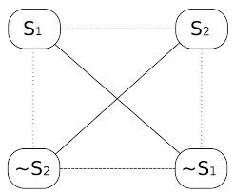
THE PLAN OF CONTENT
ALGIRDAS JULIEN GREIMAS
THE SEMIOTIC SQUARE
The concepts at the basis of a narrative structure are represented in pairs of opposite terms
Two opposites (eg S1 male, S2 female) and two contradictory (non-masculine -S1, and non-feminine -S2)
The dotted lines between S1 and -S2 and between S2 and -S2 indicate complementarity
Notes:
65

Slide 66
THE PLAN OF CONTENT
ALGIRDAS JULIEN GREIMAS
THE ACTANTIAL MODEL
An abstract model of the functions performed by the characters
It is potentially adaptable to any form of narration
These functions are called actants and are distinguished in three essential pairs:
1. Subject / Object
2. Sender / Receiver
3. Helper / Opponent
Notes:
66

Slide 67
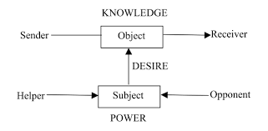
THE PLAN OF CONTENT
ALGIRDAS JULIEN GREIMAS
THE ACTANTIAL MODEL
Subject intends to achieve an Object of value
Sender proposes the motivation for the Subject
Receiver establishes the success/failure of the Subject
Helper supports the Subject in reaching his goal
Opponent tries to inhibit the action of the Subject
This superficial level always refers to a more profound, universal, archetypal level (like the distinction between good and evil)
Notes:
67

Slide 68
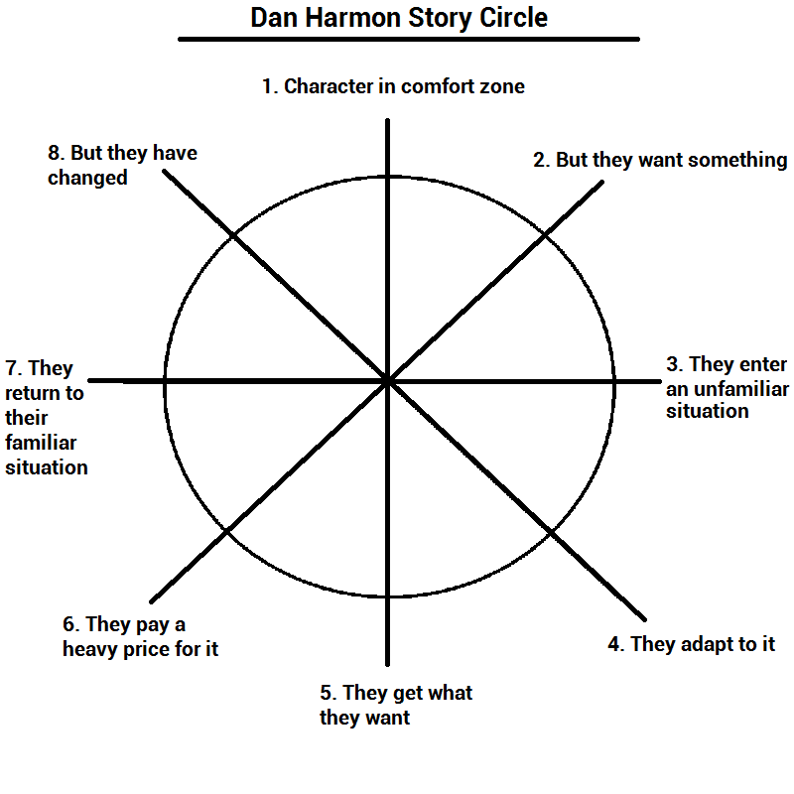
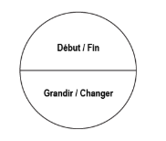
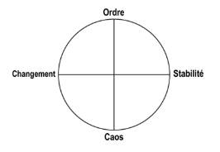
THE PLAN OF CONTENT
DAN HARMON | STORY CIRCLE
Notes:
68

Slide 69
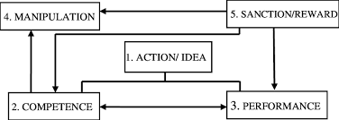
THE PLAN OF CONTENT
ALGIRDAS JULIEN GREIMAS
THE ACTANTIAL MODEL
Manipulation >> Sender gives a task to Subject
Competence >> Subject absorbs the fundamental information to achieve his purpose
Performance >> Subject acts to achieve the Object
Sanction >> Receiver recognizes the success/failure of the Subject
Notes:
69

Slide 70
THE PLAN OF CONTENT
ALEXANDER GALLOWAY
REGIMES OF THE INTERFACES
IDEOLOGICAL | Coherent Aesthetics Coherent Policy | Dominant Regime | Mass Media (eg Facebook)
ETHICAL | Incoherent Aesthetics Coherent Policy | Privileged Regime | Purely functional interfaces (eg Microsoft Word)
POETIC | Coherent Aesthetics Incoherent Policy | Tolerated Regime | Artistic interfaces (eg. Christophe Bruno's Google Adwords Happening)
TRUTHFUL | Incoherent Aesthetics Incoherent Policy | Marginal Regime | Radical Design (eg. Jodi.org)
Notes:
70

Slide 71
THE PLAN OF CONTENT
RECAP...
We can analyze any narrative system by identifying its different codes (plastic, visual, linguistic...)
Grouping the codes and attributing certain values to them based on oppositions
Associate an actant with each of the elements
Identify the regime used, asking ourselves why that regime was chosen, how society and the world are represented by that regime or if there is a change from one regime to another and why it happens
Notes:
71

Slide 72
THE PLAN OF CONTENT
ALEXANDRA SAEMMER
INTERFACIAL MEDIA FIGURES
Eight figures of speech that can be obtained from the relationship between the user's gesture, the activatable content and the activated content
Notes:
72

Slide 73
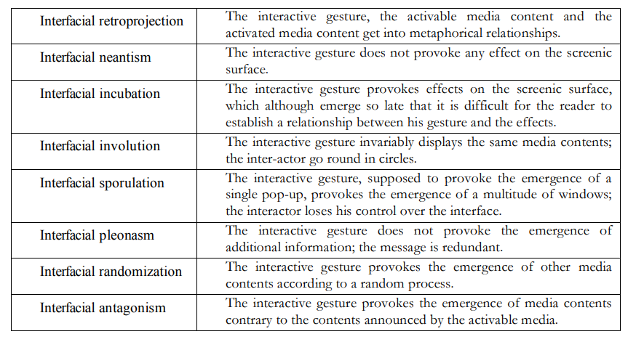
THE PLAN OF CONTENT
ALEXANDRA SAEMMER
INTERFACIAL MEDIA FIGURES
Notes:
73

Slide 74
THE PLAN OF CONTENT
ALEXANDRA SAEMMER
INTERFACIAL MEDIA FIGURES
1.
Interfacial retroprojection: the interactive gesture, the activable media content and the activated media content are in metaphorical relationships
Example: in Avventura nel castello, by typing “guarda il blasone” you obtain the answer “cadrà lo straniero” and the character we are interpreting actually falls into a trapdoor that opens suddenly under his feet
Notes:
74

Slide 75
THE PLAN OF CONTENT
ALEXANDRA SAEMMER
INTERFACIAL MEDIA FIGURES
2.
Interfacial neantism: the interactive gesture does not provoke any effect on the screenic surface
An example can be the final part of Avventura nel castello, where any command we type has no effect
Notes:
75

Slide 76
THE PLAN OF CONTENT
ALEXANDRA SAEMMER
INTERFACIAL MEDIA FIGURES
3.
Interfacial incubation: the gesture provokes hardly detectable effects on the screenic surface because the changes determined by the user's gesture emerge so late that it is difficult for the reader to establish a relationship between his gesture and the effects
In Avventura nel castello it occurs when the user let the cat drink milk discovering later that he would have to drinkit to defeat an enemy
Notes:
76

Slide 77
THE PLAN OF CONTENT
ALEXANDRA SAEMMER
INTERFACIAL MEDIA FIGURES
4.
Interfacial involution: the interactive gesture invariably displays the same media contents, and then the gesture invariably follows the same effects
In Avventura nel castello it occurs when the user keeps bumping into the mirrors, receiving the same answers, until he discovers that a mirror is actually a revolving wall
Notes:
77

Slide 78
THE PLAN OF CONTENT
ALEXANDRA SAEMMER
INTERFACIAL MEDIA FIGURES
5.
Interfacial sporulation: the interactive gesture causes unexpected effects that make the reader lose control
In Avventura nel castello it occurs when the users types the wrong formula “idiota”, causing a glitch screen
Notes:
78

Slide 79
THE PLAN OF CONTENT
ALEXANDRA SAEMMER
INTERFACIAL MEDIA FIGURES
6.
Interfacial pleonasm: the interactive gesture causes redundant messages
For example in Avventura nel castello, if the user types “guarda nano”, the parser replies “è piuttosto piccolo”
Notes:
79

Slide 80
THE PLAN OF CONTENT
ALEXANDRA SAEMMER
INTERFACIAL MEDIA FIGURES
7.
Interfacial randomization: the interactive gesture provokes the emergence of other media contents according to a random process
For example, it can occur in automatic text generators
Notes:
80

Slide 81
THE PLAN OF CONTENT
ALEXANDRA SAEMMER
INTERFACIAL MEDIA FIGURES
8.
Interfacial antagonism: the interactive gesture provokes the emergence of media contents contrary to the contents announced by the activable media
A typical example are pop-up ads that open by clicking on a streaming video
Notes:
81

Slide 82
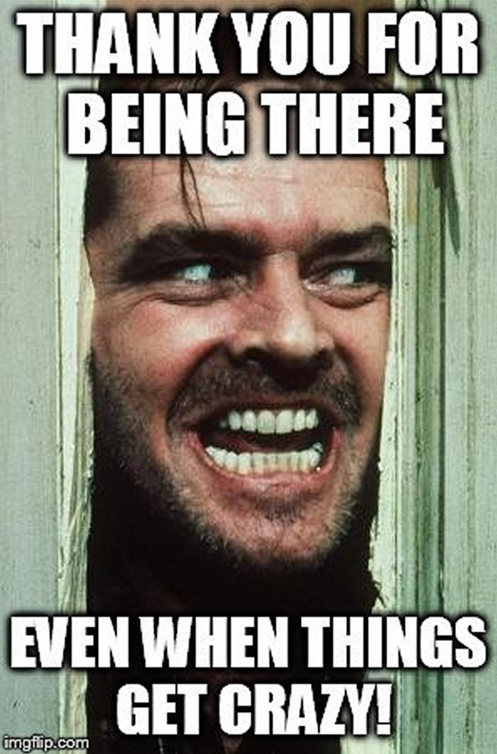
DIGITAL
SEMIOTICS
Roberta Iadevaia
roberta.iadevaia@studenti.iulm.it
Notes:
82

