Slide 1
HYPERTEXT
INDEX
What is a hypertext?
How can it be achieved?
Why has been (and still is) it made?

Slide 2
HYPERTEXT
WHAT IS IT ?
A non-sequential form of writing >>
the textual structure does not follow a line
(beginning-center-end) but takes on a reticular form

Slide 3
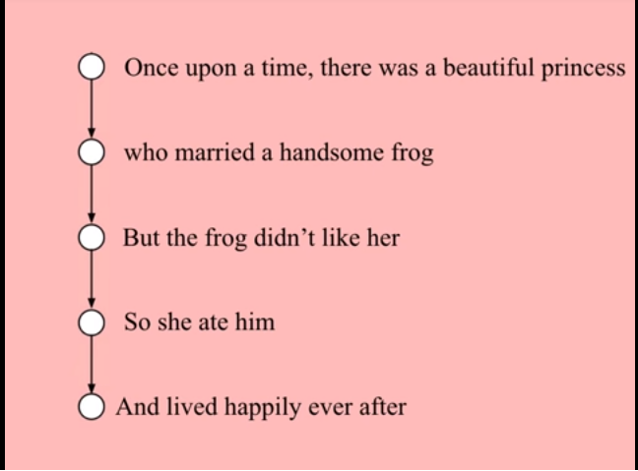
HYPERTEXT
WHAT IS IT ?
Linear structure
Chris Crawford, 2015 https://www.youtube.com/watch?v=xb8KWsy5OSM

Slide 4
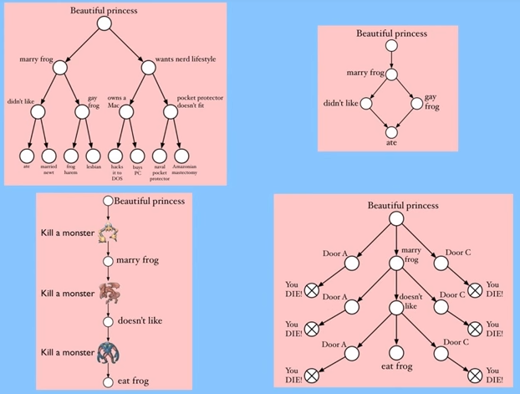
HYPERTEXT
WHAT IS IT ?
Multi-linear and linear structures (IF, CYOA)
Chris Crawford, 2015 https://www.youtube.com/watch?v=xb8KWsy5OSM

Slide 5
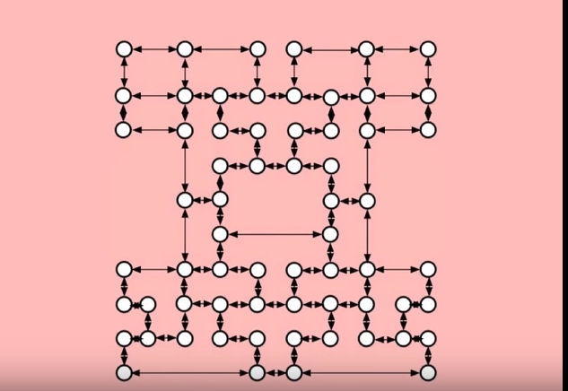
HYPERTEXT
WHAT IS IT ?
Hypertextual structure
RHIZOME *
Each node can be connected to other nodes
Chris Crawford, 2015 https://www.youtube.com/watch?v=xb8KWsy5OSM
* Gilles Deleuze, Félix Guattari, A Thousand Plateaus: Capitalism and Schizophrenia, 1980

Slide 6
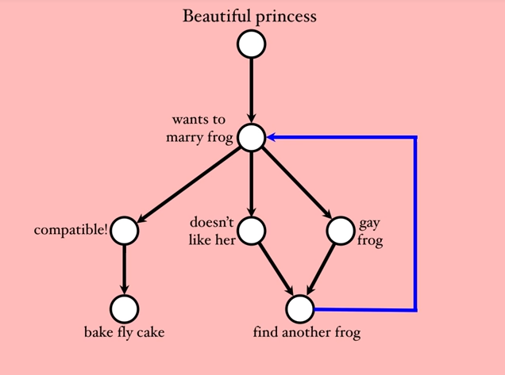
HYPERTEXT
WHAT IS IT ?
Hypertextual structure
Nodes or Lexias
(autonomous units of text)
Links are possible by
Anchors
(active elements in lexias)
Anchors different from
verbal language >>
Hypermedia
Chris Crawford, 2015 https://www.youtube.com/watch?v=xb8KWsy5OSM

Slide 7
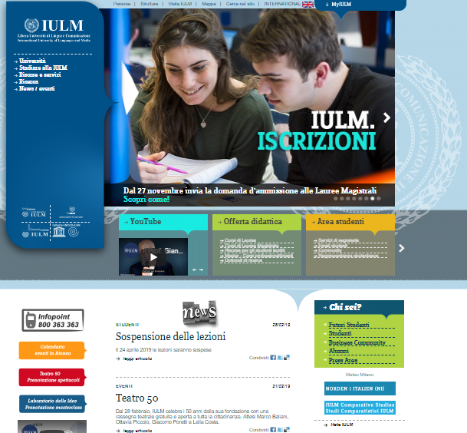
HYPERTEXT
WHAT IS IT ?
Websites are hypertext/hypermedia
Non-sequential reading (user chooses where to start
and how to continue browsing)
No fixed reading time (the reading ends when the user is satisfied)
Links can be internal (within the same website) or external (to other websites)
www.iulm.it

Slide 8
HYPERTEXT
WHAT IS IT ?
Websites are hypertext/hypermedia
The whole web is a giant hypertext
The protocol for the exchange of information on the Internet on which the web is based is called http (HyperText Transfer Protocol)

Slide 9
HYPERTEXT
HOW CAN IT BE MADE ?
Consulting information vs reading a story
Information is not linked by a cause-effect relationship >> non-sequential writing is easier
Narrative developments are connected by cause-effect relationships >>
A story is a sequence of dramaturgically significant events logically connected

Slide 10
HYPERTEXT
HOW CAN IT BE MADE ?
So... How can we preserve the cohesion and coherence of a story if the order of events may vary according to the reader's choices?
By reasoning in spatial terms (hypertext is a conceputual space) >>
treat the topical units of the text - ie the nodes – as spatial realities (eg a house, a hotel *)
* See The Hypertext Hotel project by Robert Coover (1991) described in
"The End of Books", New York Times, June 1992 http://archive.nytimes.com/www.nytimes.com/books/98/09/27/specials/coover-end.html?_r=1

Slide 11
HYPERTEXT
HOW CAN IT BE MADE ?
So... How can we preserve the cohesion and coherence of a story if the order of events may vary according to the reader's choices?
By imagining hypertext as a patchwork

Slide 12
HYPERTEXT
HOW CAN IT BE MADE ?
So... How can we preserve the cohesion and coherence of a story if the order of events may vary according to the reader's choices?
By imagining hypertext as a patchwork >>
Hypertext is composed of fragments of text that must be sewn up by the reader
Thus the reader becomes the author of his own reading
Reading is discontinuous (it proceeds by jumping) and discriminating (the reader can choose whether to follow or ignore a path)

Slide 13
HYPERTEXT
WHY IS IT MADE ?
IN SCIENCE...
Vannevar Bush's Memex (1945) storage and reading. Fictional
Theodore Nelson's Xanadu (1967) storage, reading and writing. Fictional
Tim Bernerns-Lee's World Wide Web (1990)
storage, reading and writing. Actual

Slide 14
HYPERTEXT
WHY IS IT MADE ?
IN LITERATURE...
As a product of Postmodernism * rejection of unitary systems, reflection on the materiality of the text
BUT
There are oldest examples Sterne, Calvino, Borges, Oulipo...
SO...
* Jean-François Lyotard, La Condition postmoderne, 1979

Slide 15
HYPERTEXT
WHY IS IT MADE ?
IN LITERATURE...
An expressive need which can have different goals:
Against the commonplace of literature as mimesis tool Sterne
It is “natural” because it simulates the human brain algorithmic logic (associative variables)

Slide 16
HYPERTEXT
WHY IS IT MADE ?
IN LITERATURE...
An expressive need which can have different goals:
It reflects a changed concept of time multiple and non-linear
It can help to face today's media ecosystems authors become architects as they do not write a closed work, but they design the context in which the work can take place (eg Facebook)

Slide 17
HYPERTEXT
WHY IS IT MADE ?
Hypertextual writing always determines a greater involvement of the reader >> The reader is called to actively participate in the construction of the work
WHY?
The text is a “lazy machine” *
YES, BUT
The intervention required by hypertexts is much more marked than simple interpretation and consultation
* Umberto Eco, Sei passeggiate nei boschi narrativi, 1992-93

Slide 18
HYPERTEXT
WHY IS IT MADE ?
Hypertextual writing always determines a greater involvement of the reader >> The reader is called to actively participate in the construction of the work
WHY?
It is now technically possible to create interactive works interactivity is one of the fundamental characteristics of new media
Quantum physics discoveries: there is no objective reality, but matter exists only when it is observed matter is not an independent physical object, but a dynamic process that includes both the observer and the method of observation

Slide 19
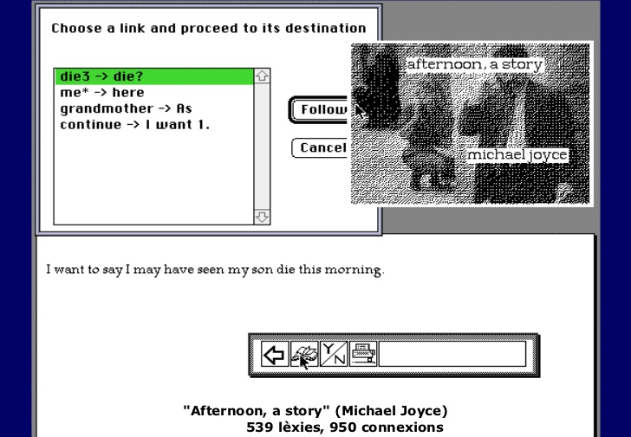
HYPERTEXT
EXAMPLES
MICHAEL JOYCE'S AFTERNOON, A STORY (1990)
Storyspace: hypertext writing and reading software
Eastegate System: one of the first publishing houses dedicated to hypertext literature
Exploratory links: reader can only navigate between lexias
Anchors can be highlighted and examined, in order not to make the reader feel too confused

Slide 20
HYPERTEXT
EXAMPLES
MICHAEL JOYCE'S AFTERNOON, A STORY (1990)
The reader is in exactly the same position as the protagonist Peter
Peter's movements reflect the structure of the hypertext
There is not a "winning" path (20 beginnings, 539 nodes and 950 links)
"We could say that there is not a story at all, there are only readings" *
The real interaction lies in the search for the plot of the story
Cohesion is only possible at the local level (individual lexias) whence the insistent use of deictic
* J. David Bolter, Writing Space: The Computer, Hypertext, And History of Writing, 1991

Slide 21
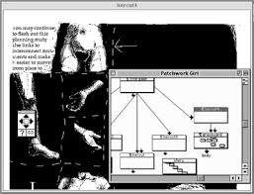
HYPERTEXT
EXAMPLES
SHELLEY JACKSON'S PATCHWORK GIRL (1995)
Postmodern work
(body, text and identity are fragmented and plural)
Body as conceptual space
(intimate relationship between author, text and reader)
Recurrent topics in Jackson's works: body, dispersion, textuality as ephemeral and transitory process

Slide 22
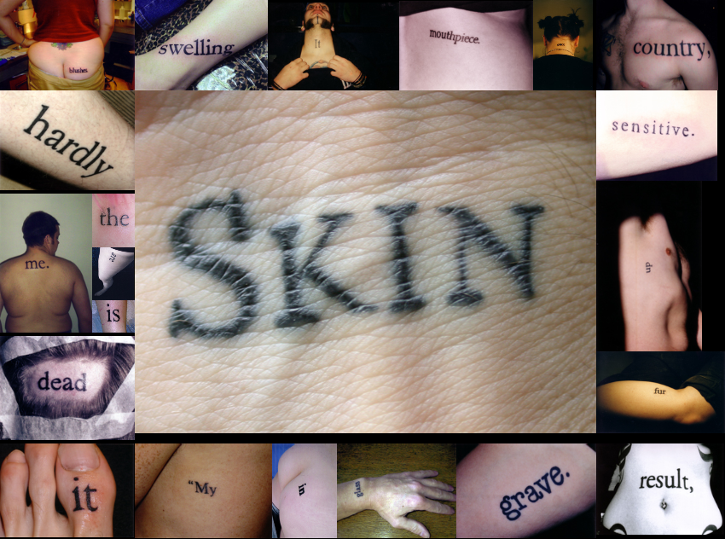
HYPERTEXT
EXAMPLES
SHELLEY JACKSON'S SKIN PROJECT (2003)
Embodied metaphor
2450 tattooed words

Slide 23
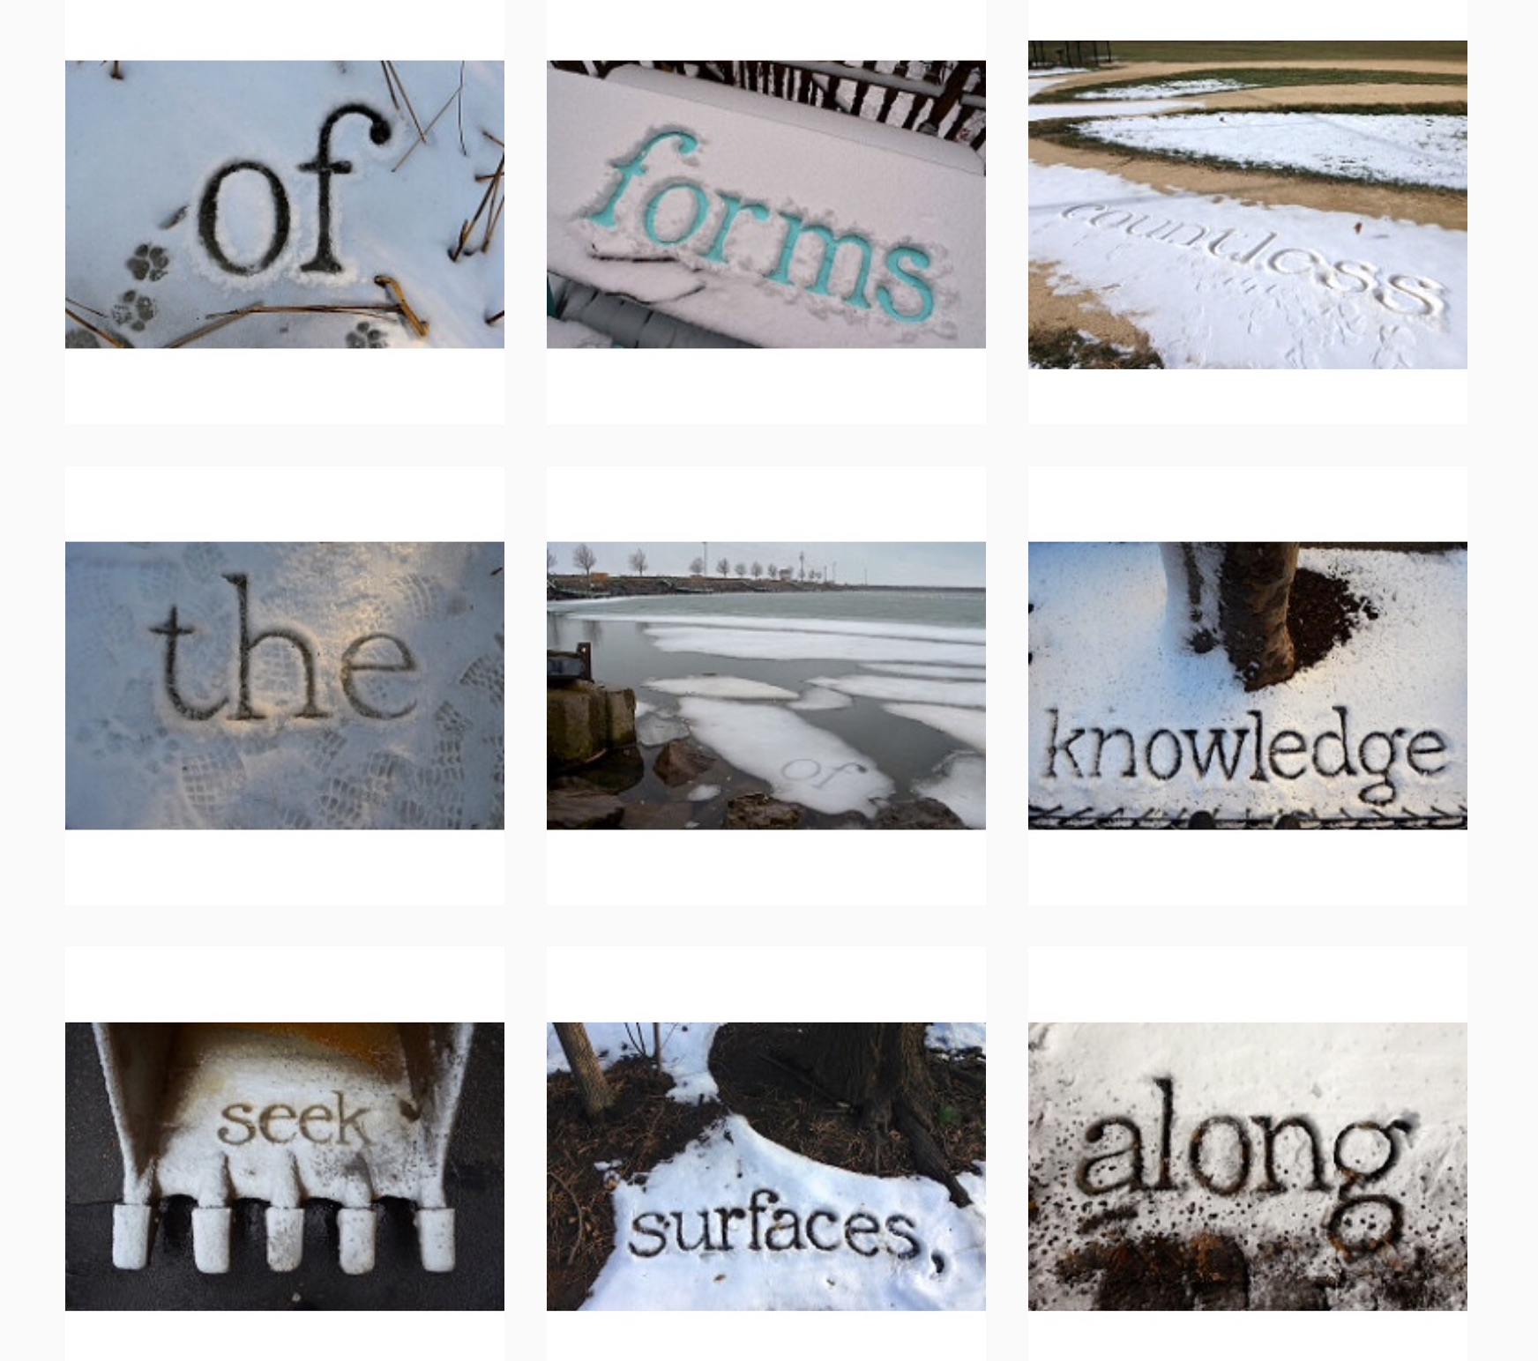
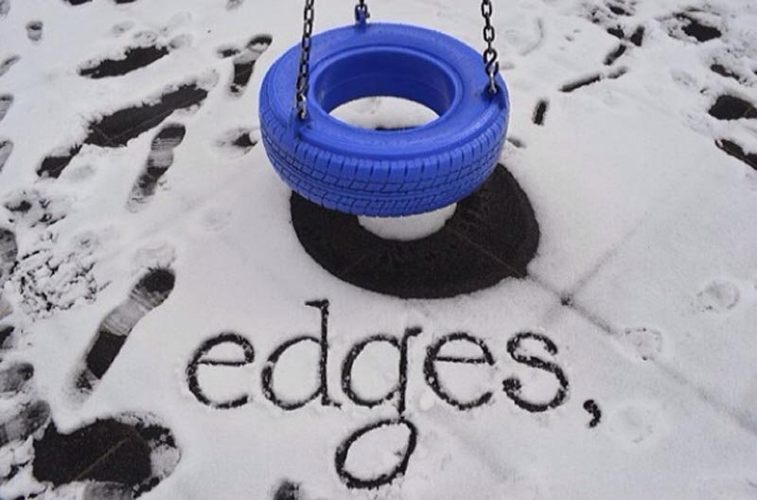
HYPERTEXT
EXAMPLES
SHELLEY JACKSON'S SNOW. A STORY IN PROGRESS, WEATHER PERMITTING (2014)
Non-neutrality of the support
Materiality of the text
Obsolescence >> a text can exists only as temporary traces of a path destined to disappear

Slide 24
HYPERTEXT
EXAMPLES >> MULTIMEDIA HYPERMEDIA
Multimedia is suitable for genres as mystery, where the user has to reconstruct a story by inspecting different clues

Slide 25
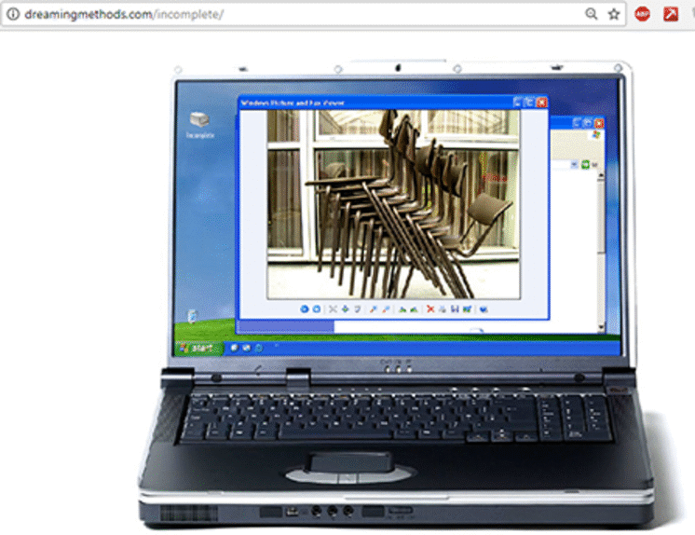
HYPERTEXT
EXAMPLES >> MULTIMEDIA HYPERMEDIA
ANDY CAMPBELL'S THE INCOMPLETE (2005)
The reader must solve puzzles interactign with a familiar interface
The interface is used in unconventional way
The habitual is made strange >> estrangement and uncanny

Slide 26
HYPERTEXT
EXAMPLES >> MULTIMEDIA HYPERMEDIA
ANDY CAMPBELL'S THE INCOMPLETE (2005)
Using existing elements (remix, mashup, etc,) is a widespread practice in digital art >> ready-made
It is due to the large amount of data accessible from the network and to software which allow to easily intervene on the data

Slide 27
HYPERTEXT
EXAMPLES >> MULTIMEDIA HYPERMEDIA
Multimedia can also be used to semantically enrich a work, to allow digressions and insights about a particular character and to emphasize the atmosphere of the work

Slide 28
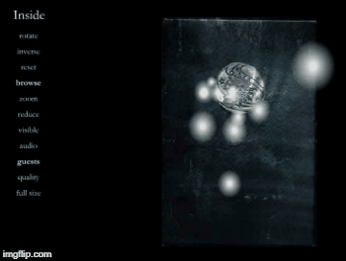
HYPERTEXT
EXAMPLES >> MULTIMEDIA HYPERMEDIA
ANDY CAMPBELL'S INSIDE: A JOURNAL OF DREAMS (2000)
A virtual diary of disturbing dreams which merges text, video and interactivity to tell the story of an elderly man being slowly poisoned by carbon monoxide
Non-linear narration by the diary format
chronological order but self-closing textual units
Reflection on support difference between paper (static) and digital (dynamic, interactive)

Slide 29
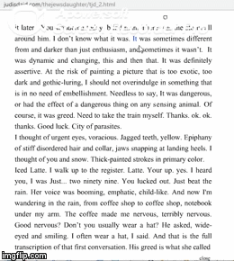
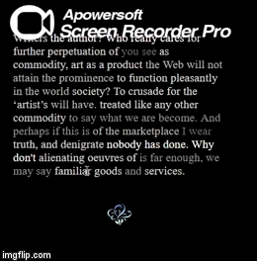
HYPERTEXT
EXAMPLES >> USE OF INTERFACES
JUDD MORRISSEY'S THE JEW'S DAUGHTER (2000) & JIM ANDREWS' STIR FRY TEXTS (1999)
Links do not lead to other pages, but modify the existing page
A mobile and fluid text
Text as a perennial palimpsest
A “nervous” text >> it seems to possess a personality
Focus on the materiality of the text and interfaces

Slide 30
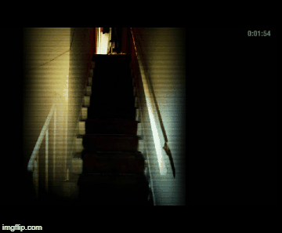
HYPERTEXT
EXAMPLES >> USE OF TEMPORALITY
ANDY CAMPBELL'S THE FLAT (2005)
Sequence-based >> work has its own preprogrammed time
Videogame + cinema + literature
Audio, graphics, shots, text, countdown >> anxiety
Read and not win

Slide 31
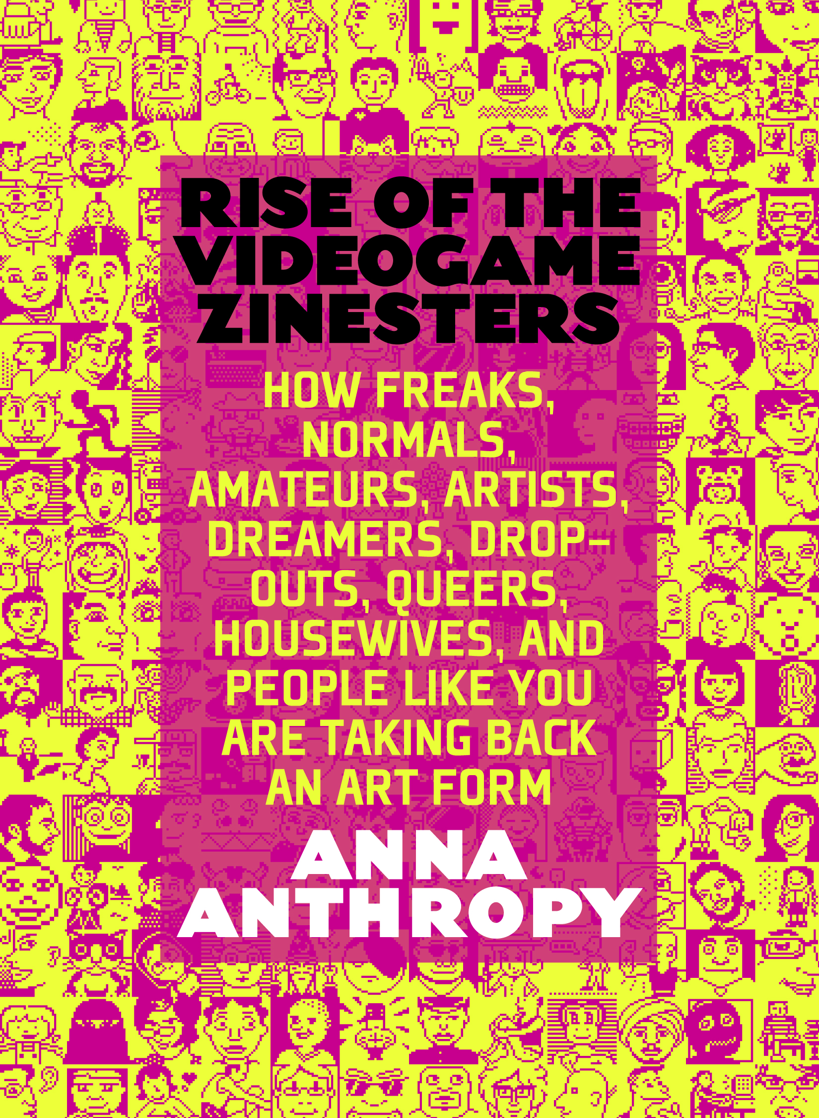
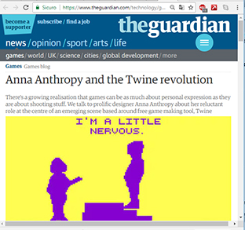
HYPERTEXT
EXAMPLES >> USE OF TEMPORALITY
ANNA ANTHROPY'S QUEERS IN LOVE AT THE END OF THE WORLD (2013)
Sequence-based >> work has its own preprogrammed time
Twine >> open source writing and reading platform

Slide 32
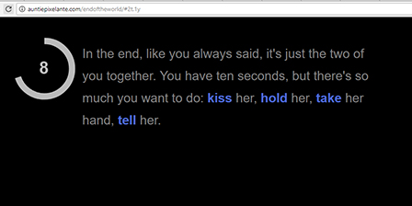
HYPERTEXT
EXAMPLES >> USE OF TEMPORALITY
ANNA ANTHROPY'S QUEERS IN LOVE AT THE END OF THE WORLD (2013)
Only 10 seconds to read the work >> executable metaphor
Short circuit between genres (videogames and prose)

Slide 33
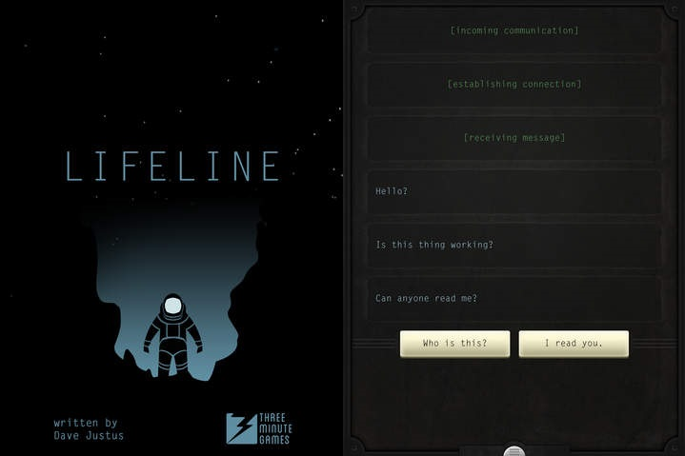
HYPERTEXT
EXAMPLES >> MOBILE APPs
THREE MINUTE GAMES'S LIFELINE (2016)
Interactive Fiction >> tree structure
Text notifications even when the app is not open
Time of the story and of the discourse coincide
The main character could not follow the user's advices illusion of intelligence

Slide 34
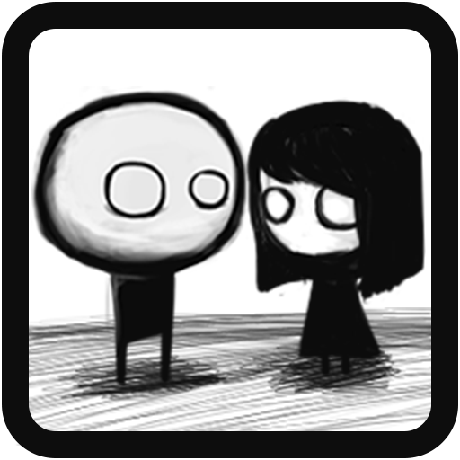
HYPERTEXT
EXAMPLES >> MOBILE APPs
IAM TAGIR'S THAT LEVEL AGAIN (2015-16)
Platform Puzzle Game

Slide 35
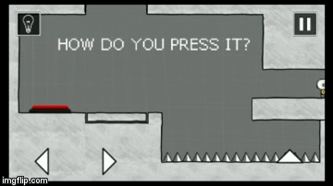
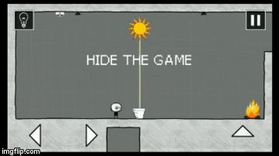
HYPERTEXT
EXAMPLES >> MOBILE APPs
IAM TAGIR'S THAT LEVEL AGAIN (2015-16)
Linear structure
Remarkable use of texts and mobile device's features

Slide 36
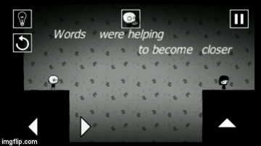
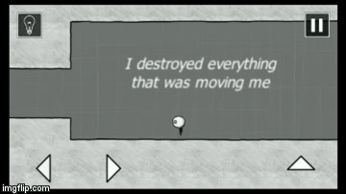
HYPERTEXT
EXAMPLES >> MOBILE APPs
IAM TAGIR'S THAT LEVEL AGAIN (2015-16)
Linear structure
Remarkable use of texts and mobile device's features

Slide 37
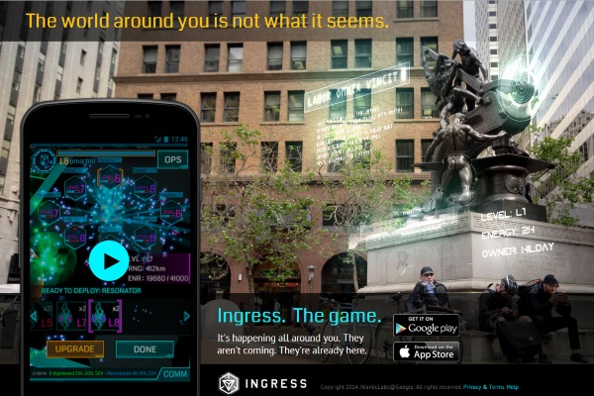
HYPERTEXT
EXAMPLES >> ALTERNATE REALITY GAMES
GOOGLE'S INGRESS (2012)
Different media and spaces
Urban Interactive Storytelling
Explorative-narrative games

Slide 38
HYPERTEXT
EXAMPLES >> ALTERNATE REALITY GAMES
Post-digital >>
Digital devices become more and more transparent and “natural”
Real and virtual reality become more and more indistinguishable
Author becomes a service architect who structures a shared physical / digital ecosystem
Physical space become a narrative, informative and emotional space
Focus on participation and social relations
One risk: managers of the imaginary (ie Google, Facebook...)

Slide 39
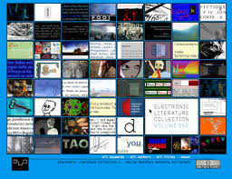
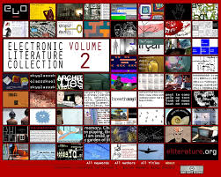
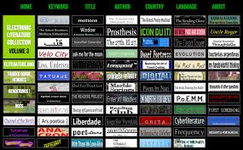
HYPERTEXT
USEFUL LINKS
ELECTRONIC LITERATURE ORGANIZATION'S ELECTRONIC LITERATURE COLLECTIONS
ELC #1
2006
ELC #2
2011
ELC #3
2016

Slide 40
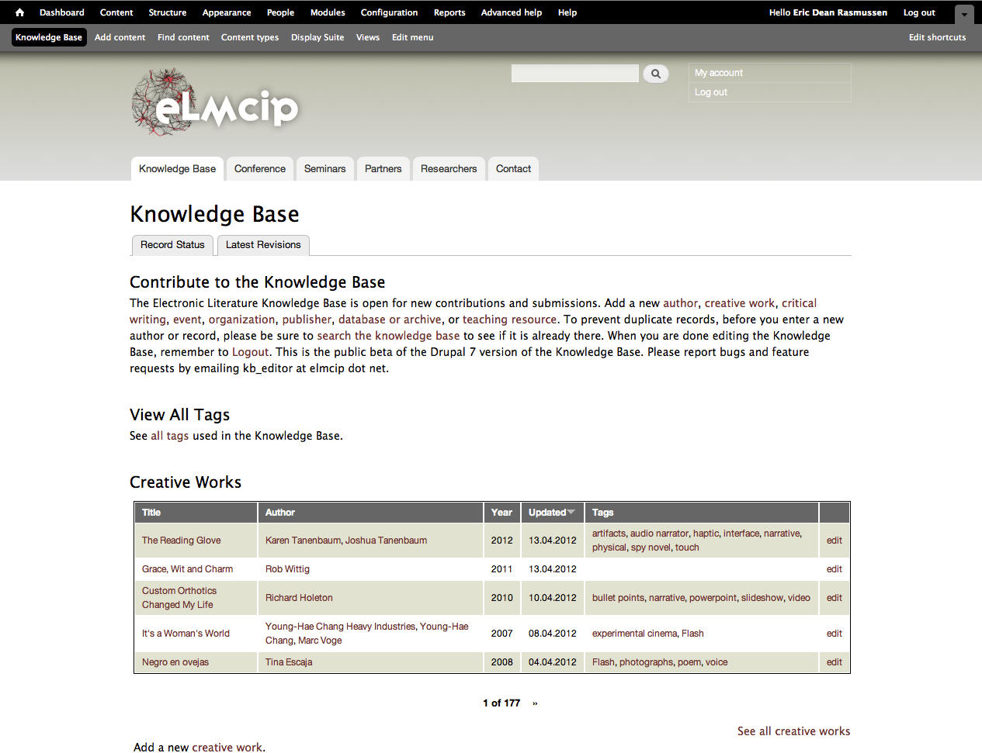
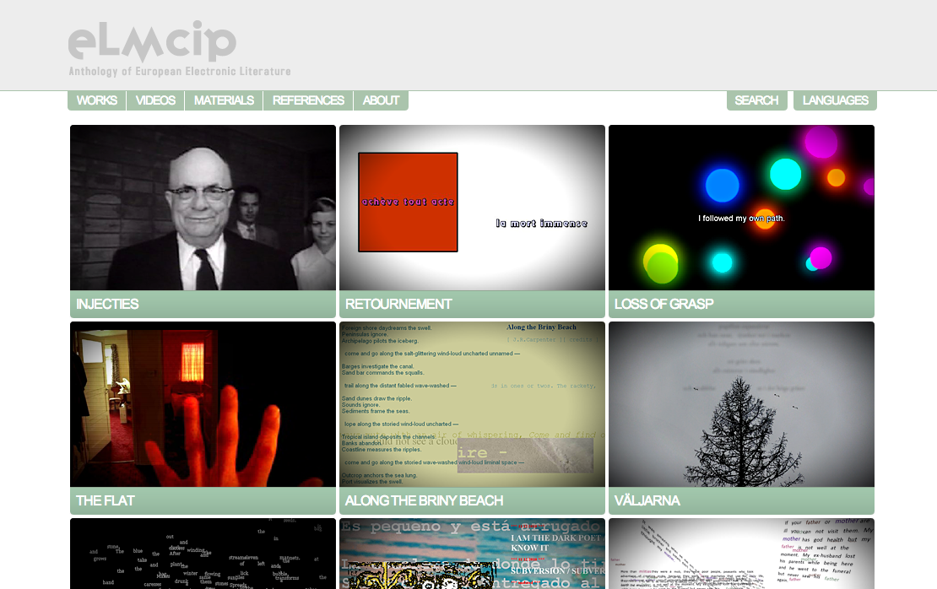
HYPERTEXT
USEFUL LINKS
ELECTRONIC LITERATURE AS A MODEL OF CREATIVITY AND INNOVATION IN PRACTICE (ELMCIP)
KNOWLEDGE BASE
ANTHOLOGY OF EUROPEAN ELECTRONIC LITERATURE

Slide 41
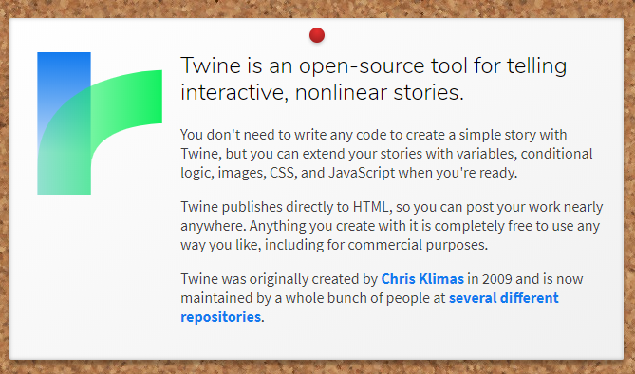
HYPERTEXT
USEFUL LINKS
TWINE
twinery.org

Slide 42
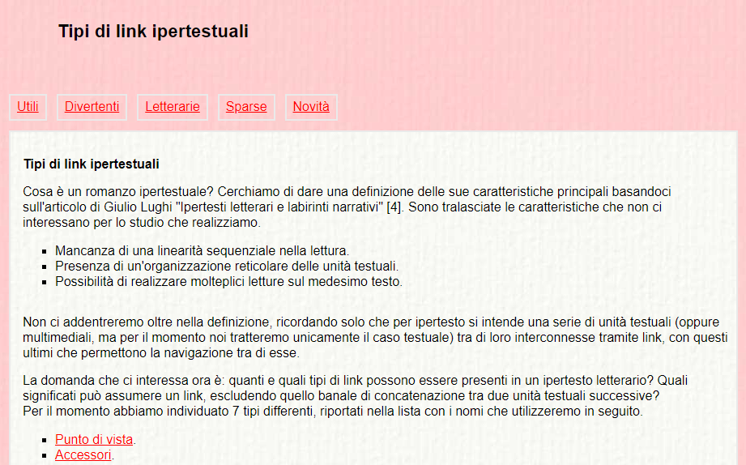
HYPERTEXT
USEFUL LINKS
HYPERTEXT'S STRUCTURES. THEORIES & EXAMPLES
MARK BERNSTEIN Patterns of Hypertext (1999)
CARLO CINATO Tipi di link ipertestuali (2010)

