Slide 1
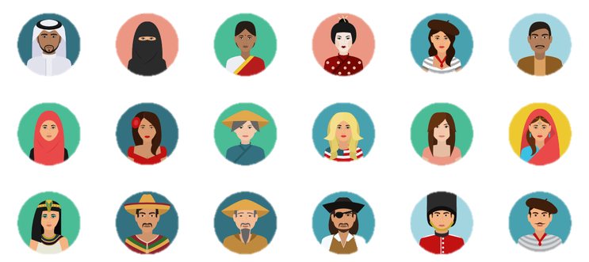
design Culture

Slide 2
Definition
the Project Management Institute (PMI) defines a project as:
a temporary endeavor undertaken to create a
unique product, service, or result.
The temporary nature of projects indicates a definite beginning and end.
The end is reached when the project’s objectives have been achieved or when the project is terminated because its objectives will not or cannot be met, or when the need for the project no longer exists.

Slide 3
Is it a Project?
Projects exist to bring about a product or service that hasn’t existed before. A project is unique. Unique means that is new.
maybe it’s been done in a very similar fashion before but never exactly in this way.
So, ask yourself:
Is it unique?
Does it have a limited timeframe?
Is there a way to determine when the project is completed?
Is there a way to determine stakeholder satisfaction?
If the answer is yes to all these questions, then you have a project.

Slide 4
Projects’ phases
There are four stages to a non-cultural project:
Definition
Planning
Execution
Closure
A cultural project is divided into six phases and a half:
Definition
Initiation
Planning
Execution
Control
Closure and Post Implementation Review

Slide 5
Artistic
Every objective pursued in the creation of a project should be...
SMART
Specific
Measurable
Achievable
Realistic
Timetable
Cultural/
cultural Policy
Entertainment
Social/
Social Policy
Training
Cultural projects’ objectives
Celebratory
Economic/
Fund Raising
Related to territorial/
public policies
Communicative/
Promotional
Marketing

Slide 6
Similarities
Complexity
Uniqueness
Timing
Cost constraints
Qualitative constraints
Resources
Execution metod
Expertise
Cultural Project
Determined time to make a product based on uncertain elements
Dynamism
Uniqueness
Result
Time of representation
Budget
Organizational, artistic and cultural qualities
Human, economic and technical qualities
Teamwork
Specialization
Importance of human factor, professionalism, innovation
Non-cultural Project
Determined time to make a product based on certain and uncertain elements
Dynamism
Uniqueness
Service or final product
Delivery time
Budget
Organizational and product qualities
Human, economic and technical qualities
Teamwork
Specialization
Importance of human factor, professionalism, innovation, technological-scientific component

Slide 7
Cultural projects
There are four main characteristics of cultural projects:
the high intensity of the human factor
the consequent high content of professionalism and different specializations
the presence of innovative objectives, mainly in an artistic and socio-cultural sense
the desire to achieve a high quality of the final result as a condition that determines the success of the event.

Slide 8
Cultural projects
An artistic production very often encompasses several other arts and can be considered as a service and not as a material good.
The theatrical product can be defined as a service of an intangible nature as it lacks physical consistency: is the result of a production process that is mainly based on the creative (immaterial) abilities of its designers, of the artists and technicians involved and, when the performance is over, on the perceptions and personal judgments of critics and spectators.

Slide 9
the characteristics of cultural projects
Uniqueness and unrepeatability of the event, even if re-proposed
Activities with a strong complexity coefficient
Dynamic form and proposal
Original and intangible content
Ambitious and innovative goals / multiple goals
Ability to serve multiple instances, individual and collective
Ability to affect the territory, an incisive tool in promotion and enhancement strategies
Orientation to the overall quality of the final result
Presence of intellectual and artistic creation processes

Slide 10
the characteristics of cultural projects
Indeterminacy of the final result: on the market without being able to "test" it
Dynamic nature: artisanal processes and latest-generation technologies, in particular digital and virtual ones
Ability to integrate logic and inter / intra disciplinary fields
Presence of professionalism, skills, different specializations
Multiplicity of cultures and disciplines involved
Duration established by determined beginning and end

Slide 11
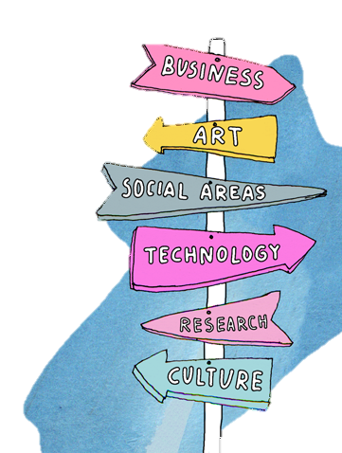
Projects’ phases in culture

Slide 12
Definition and Initiation
The aim of the Definition phase is to develop the artistic idea and the cultural hypothesis that underlie the will of one or more artists, operators or a cultural organization to carry out a project, exploring its potential in general terms.
The aim of the Initiation phase is to verify the feasibility of the project and structure it, formalizing the development path in a document that contains a clear indication of the costs, times and resources needed to carry it out.

Slide 13
Definition
Some steps are needed in this phase which allow a better success of the project draft:
Identify needs and motivations
Develop insights and key elements
Focus on the possible objectives of the project
Predict the expected results (products; services; benefits)
Maintain the overall consistency of the project
Evaluate the idea's compliance with expectations
Discuss the idea with internal subjects and reach a formal approval

Slide 14
Definition
It is important to keep in mind some of the project's areas of impact:
Socio-economic-demographic field (levels of education, economic situation, existing businesses, civil life events, etc.)
Organizational field (dedicated and non-dedicated spaces, infrastructures, communication routes, accommodation facilities, etc.)
Political-institutional field (regulations in force, institutional arrangements, guidelines and attitudes, etc.)
Artistic-cultural field (predominant subjects and initiatives, traditions, habits and attitudes)

Slide 15
Definition
Project environment represents a connection, where the project is processed!
It impacts the project and is, therefore, conditioned.
Such an interaction is provided by numerous factors as operational, physical, ecological, social, cultural, economic, psychological, financial, organizational...
The environment not only formulates the project but also estimates it!

Slide 16
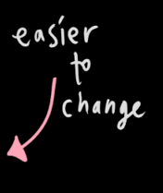

Slide 17
PROJECT ENVIRONMENT
Cultural | Social
International | Political
Physical
OF ALL THE FACTORS, THE PHYSICAL ONES ARE THE EASISEST TO UNDERSTAND. IT IS THE CULTURAL AND INTERNATIONAL FACTORS THAT ARE OFTEN IGNORED.
HOW A PRODUCT IS RECEIVED CAN BE VERY DEPENDENT ON THE INTERNATIONAL CULTURAL DIFFERENCES.

Slide 18
THE MEANING OF COLORS IN DIFFERENT CULTURES
Color | United States | China | Japan | Egypt | France
Red | Danger, stop | Happiness | Anger, danger | Death | Aristocracy
Blue | Sadness, melancholy | Heavens, clouds | Villainy | Virtue, faith, truth | Freedom, peace
Green | Novice, apprentice | Ming dynasty, heavens | Future, youth, energy | Fertility, strength | Criminality
Yellow | Cowardice | Birth, wealth | Grace, nobility | Happiness, prosperity | Temporary
White | Purity | Death, purity | Death | Joy | Naturality

Slide 19
Initiation
Questions to be answered in the initiation phase include the following:
Why this project?
Is it feasible?
Who are possible partners in this project?
What should the results be?
What are the boundaries of this project (what is outside the scope of the project)?

Slide 20
Definition - Some fundamental questions
What needs to be shown and what needs to be said?
How can images convey ideas and emotions that words cannot (and vice versa)?
What is the most direct way to convey ideas/emotions in the project?
How can you give the audience more time to assimilate an image or take ideas into account?

Slide 21
Definition - Some fundamental questions
What do the project want to communicate?
What does this project really mean?
Where is the personal perspective in the project?
How can you keep the audience involved?
What emotion the project wants to leave?
How do music/sounds affect the project?

Slide 22
PLANNING
Planning is the process by which all the activities are identified:
the links that interconnect them
the duration
the costs
The assignment of the necessary resources
It is an investment of time that saves time and energy in the future.

Slide 23
PLANNING
This phase is very complex and requires:
Information management (general file)
Programming (place, period, context)
Identifying operational activities (what needs to be done)
Scheduling of activities (when and how long)
The identification and allocation of resources (responsibilities)
Work organization (who does what, how)
The economic-financial plan and fund raising (budget, cash flow)
The communication and marketing plan
Planning of control operations and verification tools
Risk assessment (what to do if there are unforeseen events)

Slide 24
What to do in this phase
Collect requirements
Create a detailed estimate
Research the market
Write specifications

Slide 25
Execution
In the Execution phase the project is materially realized
there are visible results of what was prepared and designed following the indications of the plan content.

Slide 26
Execution
The project execution has three major focuses.
Managing people. Because majority of the project activities are handled by the project team. And project activities are assigned to project team members.
Following processes. Steps of how to do what are described in project management processes and during project execution, these processes are followed.
Distributing information. Since the majority of the project work is delivered throughout the project execution, progress information about the project is distributed to the project stakeholders frequently during executing phase. Meetings with the project team are organized to review the current status of the project and the next steps.

Slide 27
Control
Project Control Phase deals with measuring the project performance and progression in accordance to the project plan.
Risk and Change Management Plans developed during the Plan Phase are put to use now to ensure the success of the project.
If there are deviations from the project plan corrective actions are recommended to bring the project back into alignment with the project plan.

Slide 28
Control
Phase activities:
Provide Regular Status Reports as outlined in the Communications Plan
The key is to keep the receivers of the reports as the focal point, communicating the information that will be most helpful to them: the true status of the project, including accomplishment, issues, risks, scope changes, and so on.
Track and Manage Project Issues and Risks
Maintain a complete tracking log for all issues and risks, including those that have been resolved.
Conduct Project Change Management
Track project change control requests required for scope changes from the initial plan and seek authorization from relevant stakeholders.

Slide 29
Closure
The Project Closure Phase is the phase where you will formally close your project and then report its overall level of success to your sponsor.
This phase involves:
passing the documentation to the business
cancelling supplier contracts
releasing staff and equipment
informing stakeholders of the closure of the project

Slide 30
Post implementation review
The objective of the post-implementation review phase is to evaluate the overall effect of a project, after a reasonable period of time has passed since its effective date.
This includes:
Evaluating whether a project is accomplishing its intended purpose
Identifying, wherever possible, costs and benefits.
Identifying unintended consequences.

Slide 31
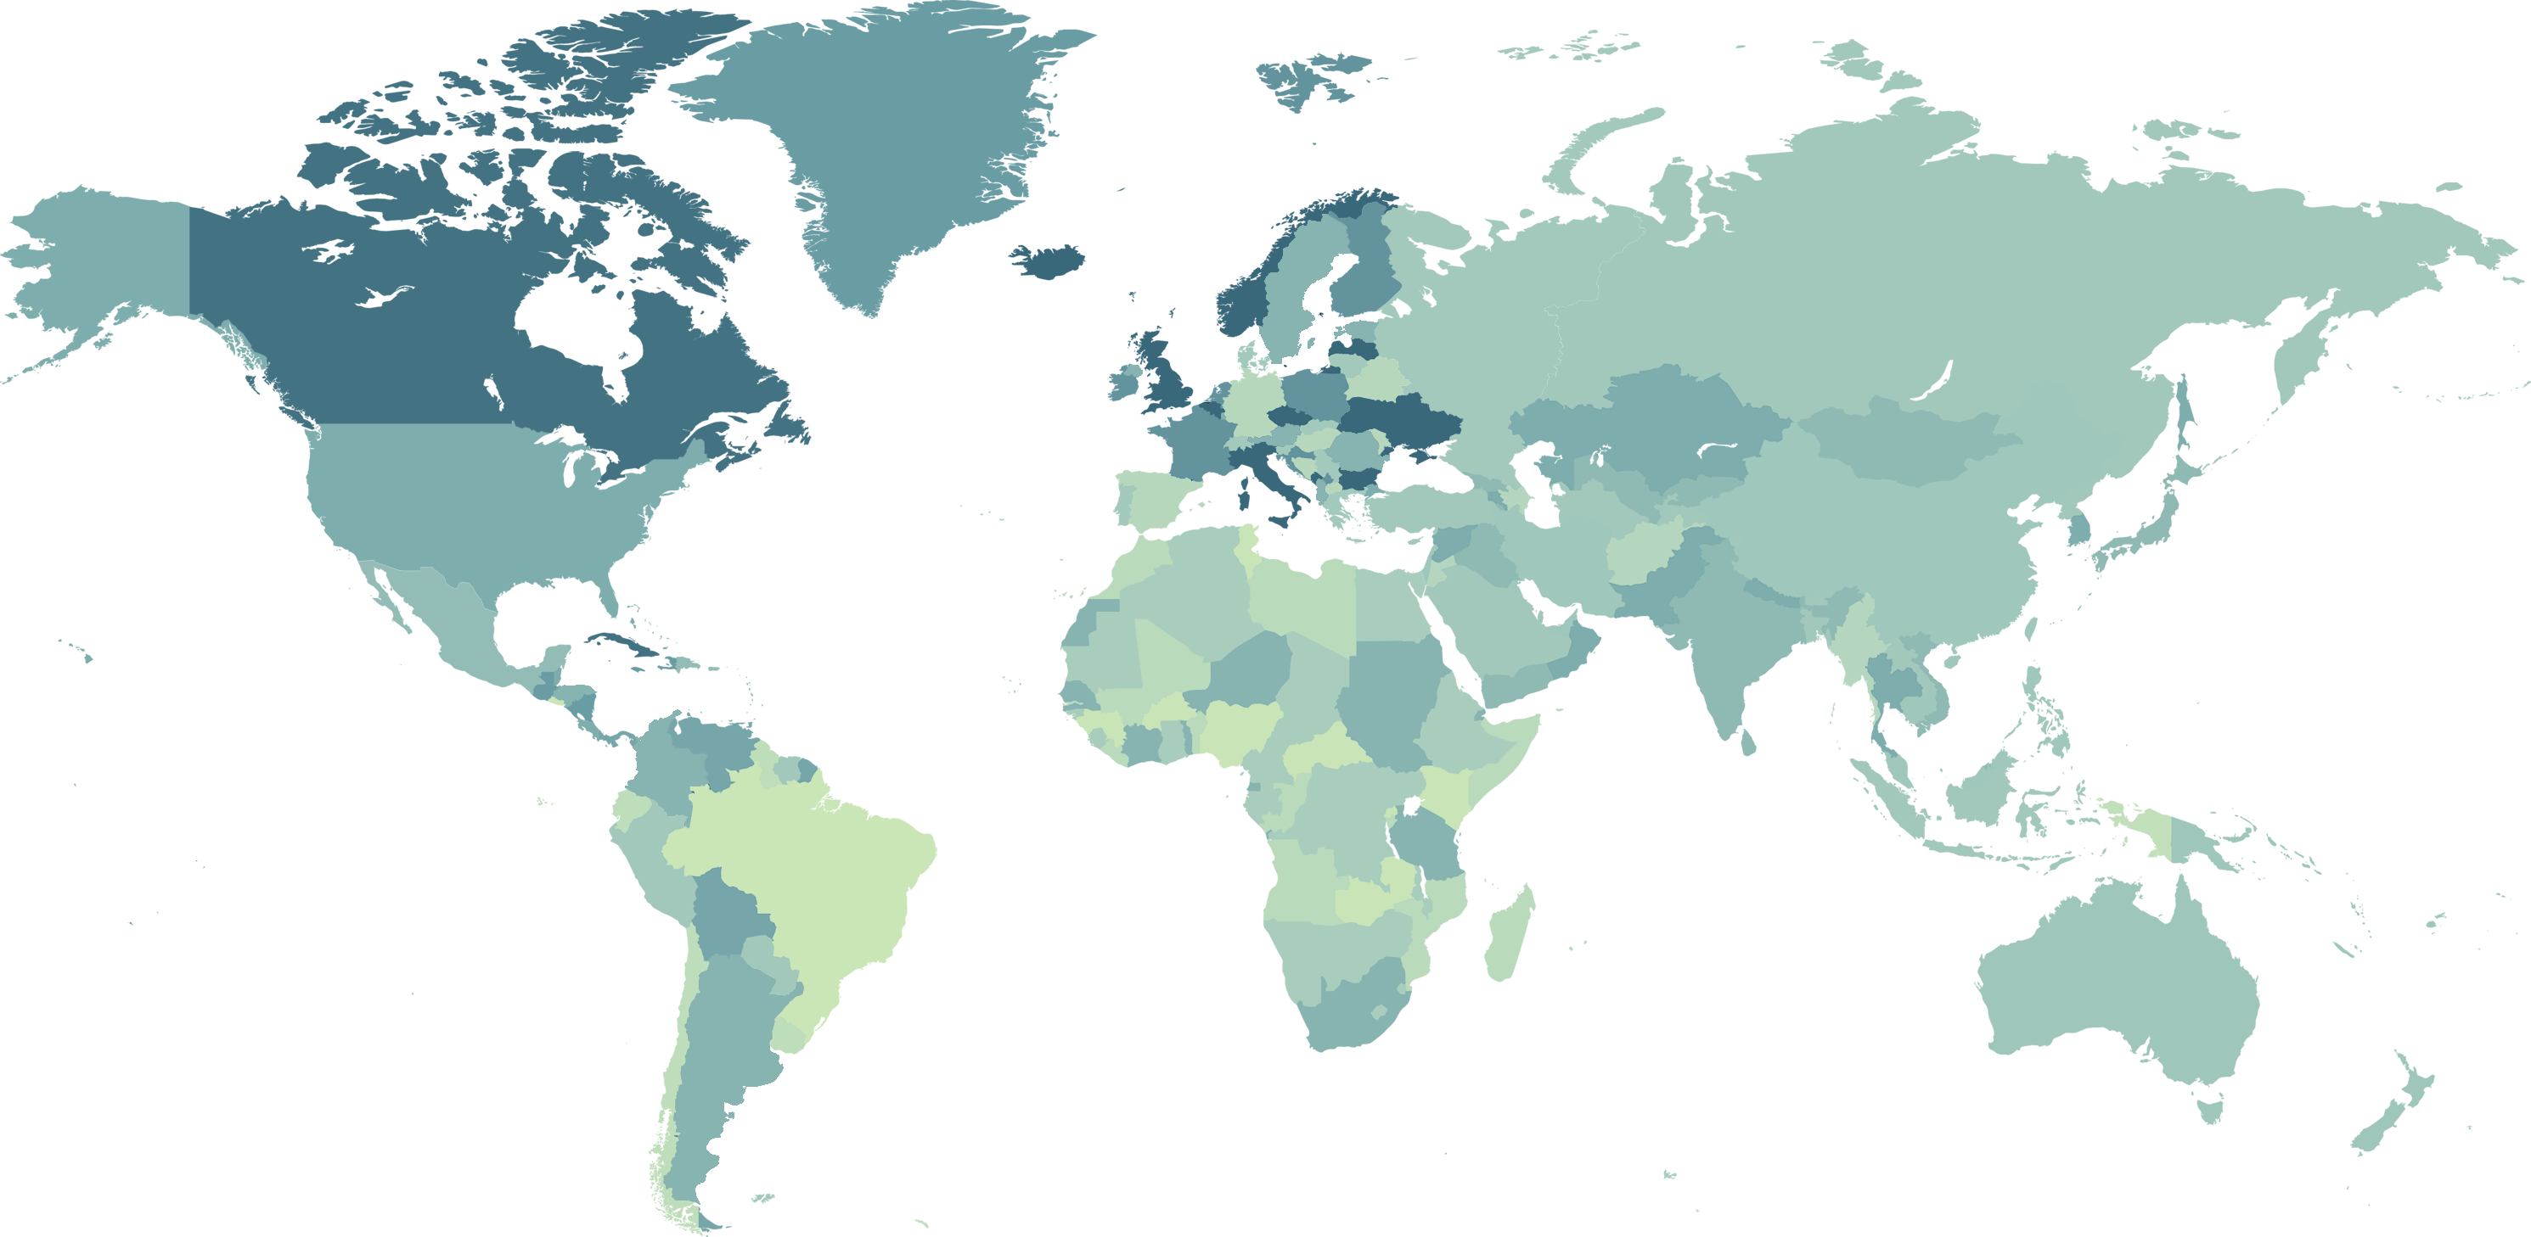
LOCATIVE NARRATIVES

Slide 32
According to the United Nations Educational, Scientific and Cultural Organization (UNESCO) cultural heritage is defined as:
«the legacy of physical artefacts and intangible attributes of a group or society that are inherited from past generations, maintained in the present and bestowed for the benefit of future generations»

Slide 33
Locative narratives
Locative artworks based on digital mobile technologies are a relatively new phenomenon.
Yet art practices based on site-specific works and nomadic strategies are not just old, but ancient.
Locative art by its very nature trespasses into the realm of Public Art, but by its interaction with the audience transforms our notions of site-specific and nomadic practices defined by artists such as Richard Long, Hamish Fulton, Vito Acconci.

Slide 34
Locative narratives
The technologies used to guide along and inform about historic places and buildings have gone through a rapid development.
The current technologies offer endless possibilities, but it seems the application of these technologies in order to facilitate a powerful experience falls behind.
professionals from both literary, media, education, tourism and cultural heritage fields of study have expressed a need to develop innovative, medium specific ways of telling stories about cultural heritage with the new technologies at hand.

Slide 35
Digital Locative narratives
Mobile digital storytelling or any combination of digital with either mobile or locative and either storytelling or narrative, refers to the telling of stories of physical environments through computerized, location independent technologies.
Locative usually refers to specific locations, and is in some cases interpreted as location dependent storytelling, in which case the information is only available when physically being present at a specific location.

Slide 36
Digital Locative narratives
In line with Marshall McLuhan’s famous “the medium is the message” we can say the medium will often impact the ways a story is told, distributed, and experienced.
This impact is often:
because of issues like the interface - does a spectator want to compose a long text on the small keyboard of a mobile phone?
Because of the cultural expectations - do we read stories on an iPad in very similar ways that we read them on a print book because that is what is culturally accepted?

Slide 37
«A transmedia story unfolds across multiple media platforms, with each new text making a distinctive and valuable contribution to the whole.
In the ideal form of transmedia storytelling, each medium does what it does best - so that a story might be introduced in a film, expanded through television, novels, and comics; its world might be explored through game play or experienced as an amusement park attraction»
Jenkins (2006)

Slide 38
Location-based media (LBM)
LBM delivers content directly to the user of a mobile device dependent upon the location.
Location information determined by means such as mobile phone tracking and other real-time locating system technologies like Wi-Fi can be used to customize media content presented on the device.

Slide 39
Location-based media (LBM)
Locative media is closely related to augmented reality - the reality overlaid with virtual reality - and pervasive computing - computers everywhere!
Whereas A.R. strives for technical solutions, and pervasive computing is interested in embedded computers, locative media concentrates on social interaction with a place and with technology.

Slide 40
Location-based media (LBM)
As it happens with digital media, where the medium itself is not digital but the content is digital, in locative media the medium itself might not be location-oriented, whereas the content is location-oriented.
Many locative media projects have a personal (memory), critical or social background.

Slide 41
«for some reason - regional artists, citizen journalists and environmental organizations for example - a sense of place is a particularly important aspect of representation, and the starting point of conversations»
Jillian Hamilton
University of Technology, Kelvin Grove, Qld. Australia

Slide 42
Location-based media (LBM)
Locative media, given the dynamism and hybridity of cities, extends the internet landscape to physical environments where people forge social relations and actions.
in using locative technologies, users can expand how they communicate in their environment and, in doing so, explore deeply urban interactions.
Users can assume a more active role in constructing the environments they are situated in accordingly.

Slide 43
The Transborder Immigrant Tool
Developed by Electronic Disturbance Theater 2.0/b.a.n.g. lab, the T.B.T. was a mobile phone application intended to guide individuals who were making their way to the United States through the deserts of the U.S./Mexico borderlands to water.
The application delivered poetry to its users in an effort to assist in their emotional and mental well-being while offering information about survival during the journey.
The app was designed for use on a cheap, GPS-enabled Motorola phone, which would be distributed in Mexico to those crossing the border. It was released as an open-source tool for potential deployment at other border crossings.

Slide 44
The Transborder Immigrant Tool
The creators of The Transborder Immigrant Tool considered it to be a performance intervention that included the app itself, its API, public reactions, and a government investigation.
By the time TBT was ready for distribution in 2011, the border crossing had become more dangerous, presenting the risk that carrying a TBT phone might put users in danger.
While the project was never distributed to its intended users, it still succeeded in confounding systems of political control, creating a call to action that resonated internationally, and using poetry to “dissolve” the US-Mexico border.

Slide 45
Can you see me now?
Narrative: location based game where you explore the virtual city, all the while trying to avoid the runners in the real city
Modes: text, images, audio, video, AR, 3D animations, cartography, Wi-Fi, GPS
Is an urban chase game developed by Blast Theory and The Mixed Reality Lab, where performers on the streets of a city use handheld computers, GPS and walkie talkies to chase online players who move their avatars through a virtual model of the same town.
The physical city is overlaid with a virtual city to explore ideas of absence and presence. By sharing the same ‘space’, the players online and runners on the street enter into a relationship that is adversarial, playful and filled with pathos.

Slide 46
I Promessi Sposi 3.0 - The Betrothed 3.0
Narrative: The evolution of the city of Milan, revisited through a time machine
Modes: text, images, audio, video, AR, 3D animations, cartography
The app, not public, is developed as part of a research at the University of Milano-Bicocca to improve the experience and informal learning of historical knowledge.
The applications revisits the places visited in the novel and explores how these places changed over time: some of the historic places are still visible, some of them are lost. The three periods the time machine revisits are current day Milan, Manzoni’s 19th century Milan, and Renzo Tramaglino’s 17th century Milan.

Slide 47
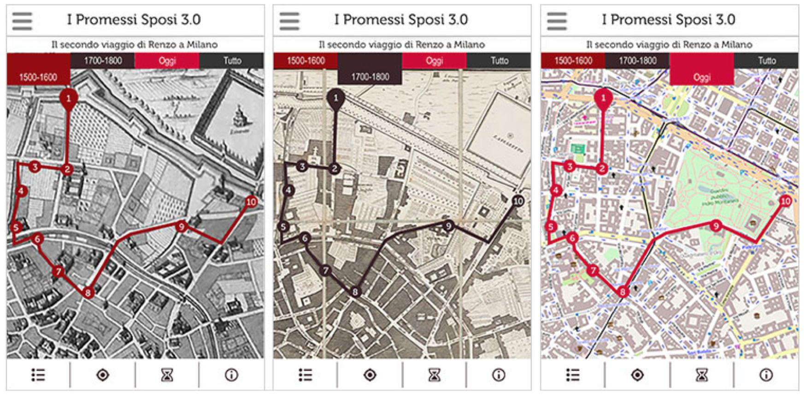
For each time period the app displays a contemporary map of Milan; the Artaria’s map from 1820; Cartaro’s map from 1581.
(Bollini 2017)

Slide 48
A Hollow Body
Modes: text, images, audio, physical textures
Narrative: the self and the City of London, narrated by a male voice
This application does not intend to give factual information, but follows a fictional story, inviting the user to observe the public space of London.
A very simplistic interface and a soundtrack directs the user through the physical space.
The app uses GPS, but the user can access the content by confirming to be at the location. The narrator is introduced as the self: the user becomes the main character of the script and performance.
The application itself is mostly audio centred, but the story transcends the virtual and involves the physical space and sensations.

Slide 49
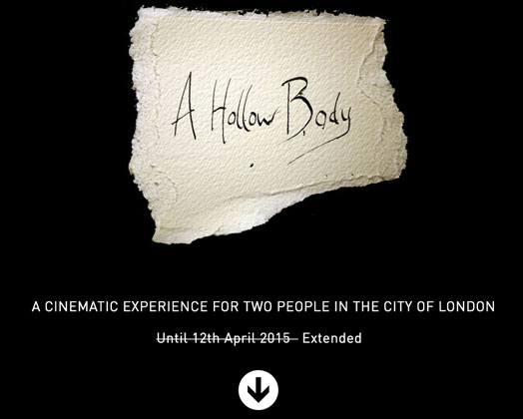

Slide 50
Locative narratives
The narratives in general stay very close to historical or factual information.
it might be interesting to find innovative ways of creating digital locative narratives that not just utilize the medium, but that exploit the interplay of medium, narrative and site.
«We can't just blindly copy from one museum to another or replicate old formats on the new devices. Creating a mobile experience is a design activity and must take the context and audience needs into consideration»
Lindsey Green, Alyson Webb and Martha Henson

Slide 51
Dott.ssa Camilla Fava
email: camilla.fava.89@gmail.com

